Slide 1
Pattern Matching
(Đối sánh mẫu)

Slide 2
table of contents
01
02
Introduction
Substring Search algorithms
2.1. Brute force algorithm
2.2. Knuth-Morris-Pratt algorithm
2.3. Boyer-Moore algorithm
2.4. Rabin Karp algorithm
03
Regular Expression
(optional)

Slide 3
01.
Introduction

Slide 4
Introduction
What is pattern matching? What is substring search?
Pattern matching: a technique used in computer science to check a given sequence of tokens for the presence of the constituents of some pattern.
Substring search: given a text string of length N and a pattern string of length M, find an occurrence of the pattern within the text.
What is the difference between pattern matching and substring search?

Slide 5
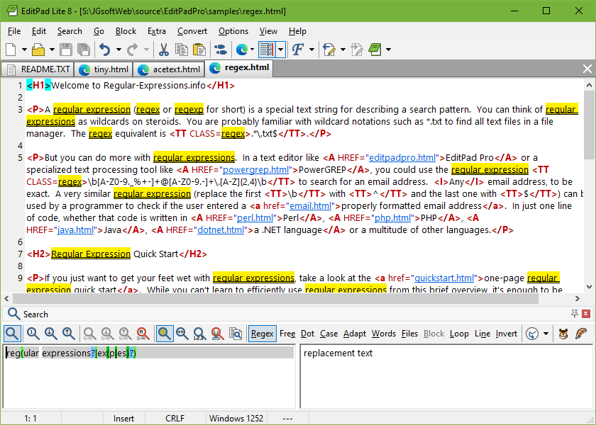
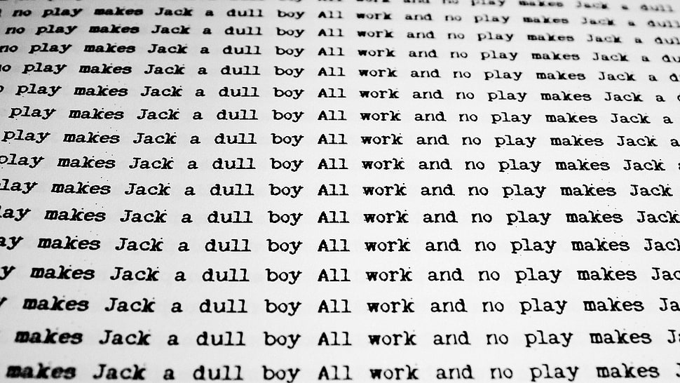
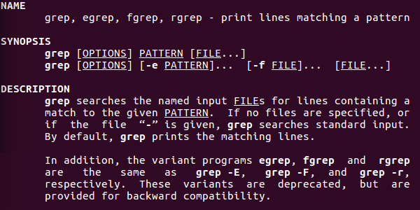
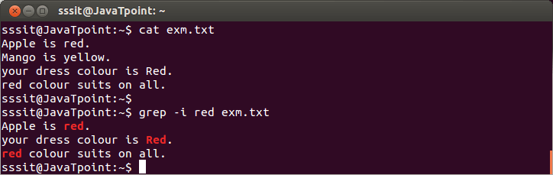
Why we need to learn about “Pattern matching”?

Slide 6
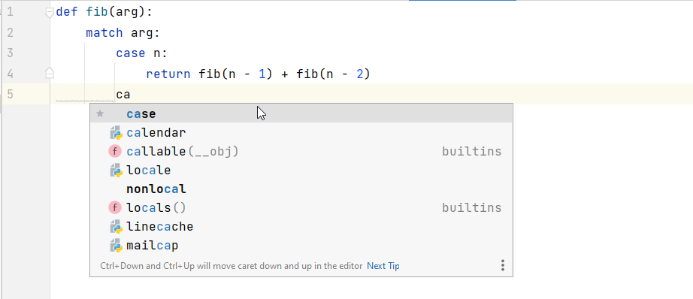
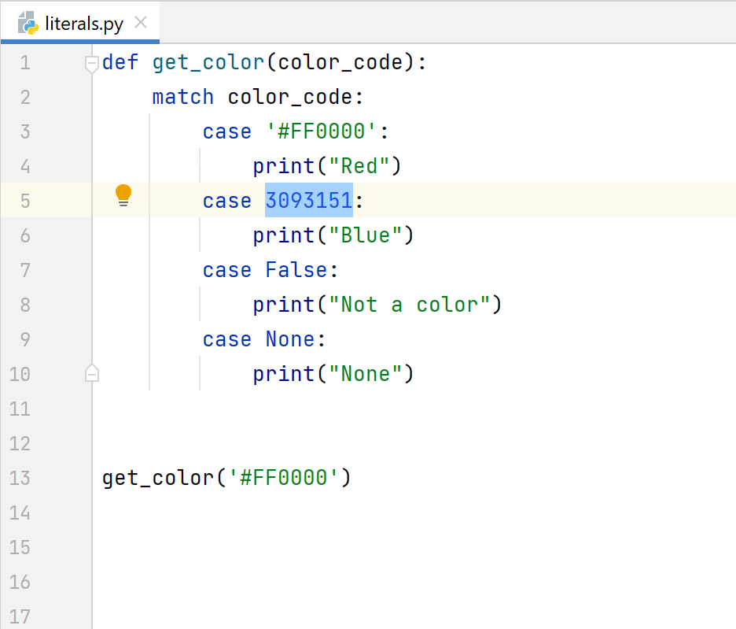
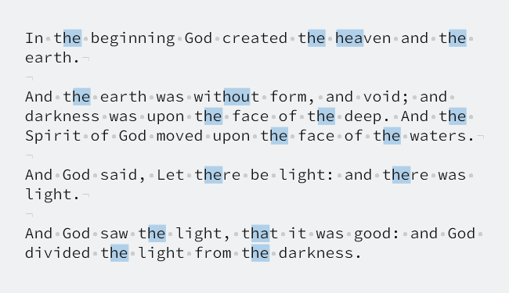
Why we need to learn about “Pattern matching”?

Slide 7
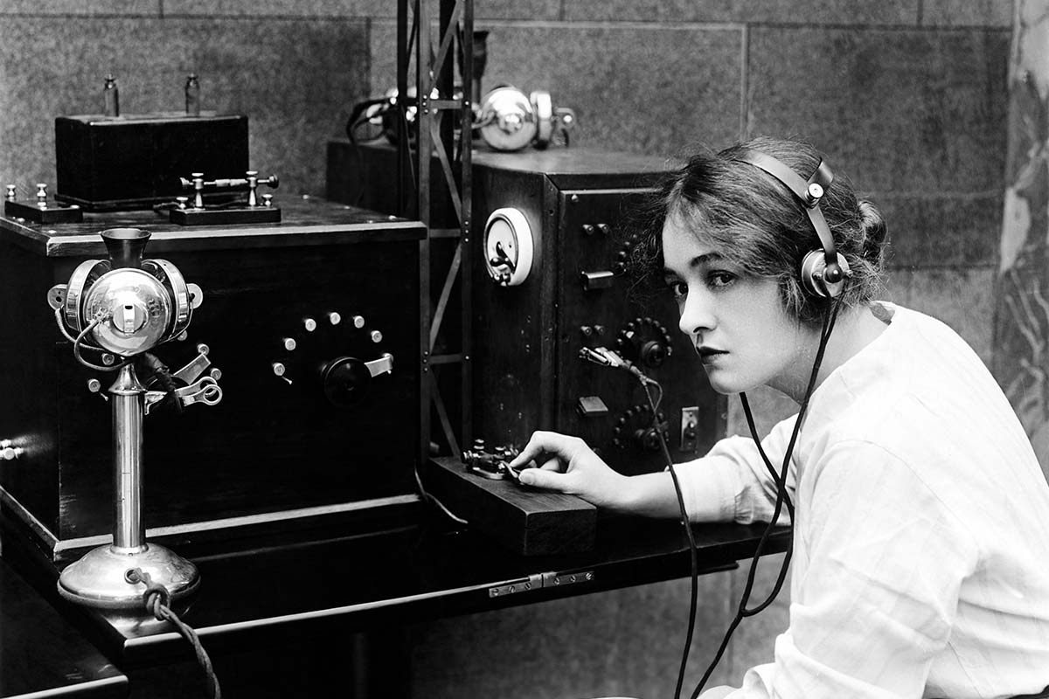
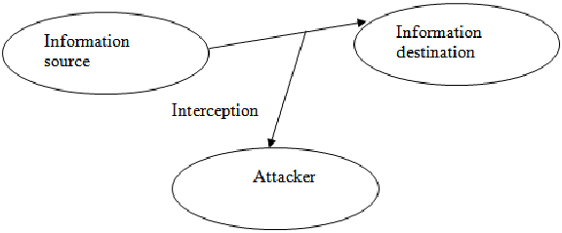
Why we need to learn about “Pattern matching”?

Slide 8
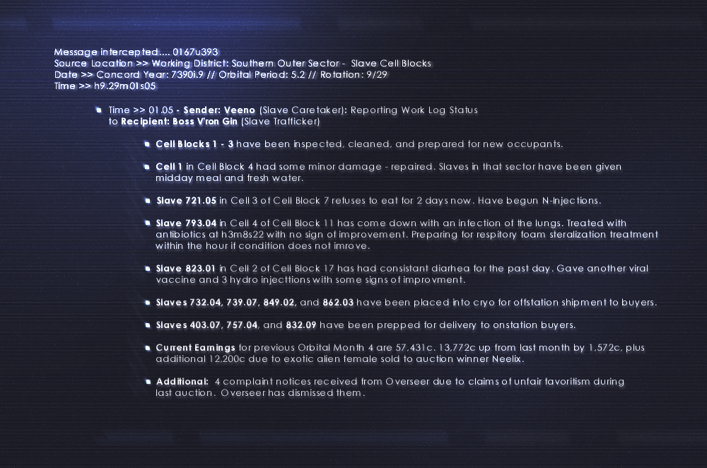
Why we need to learn about “Pattern matching”?

Slide 9
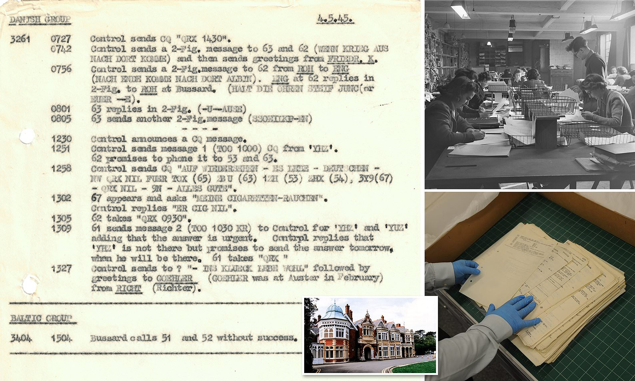
Why we need to learn about “Pattern matching”?

Slide 10

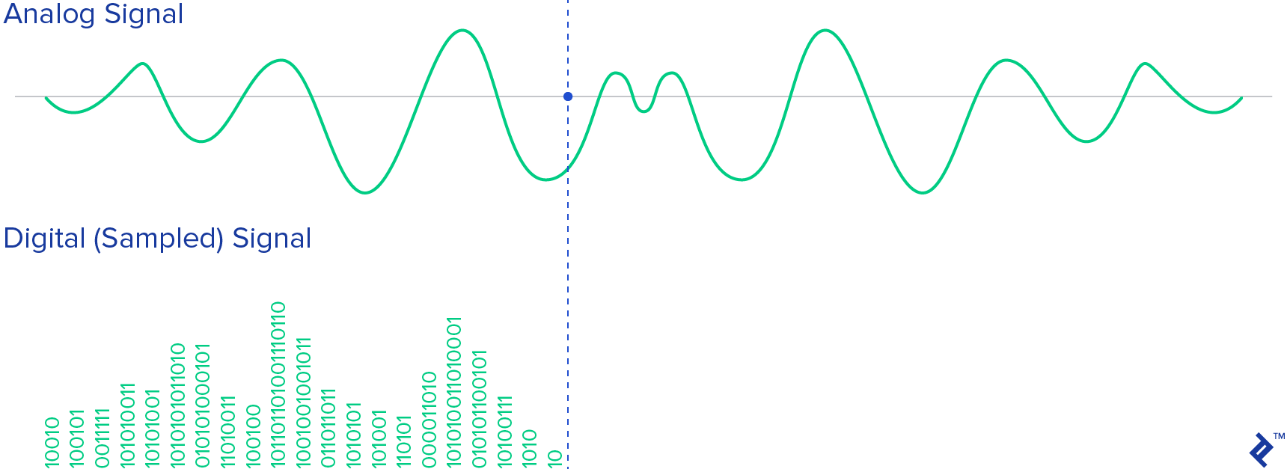
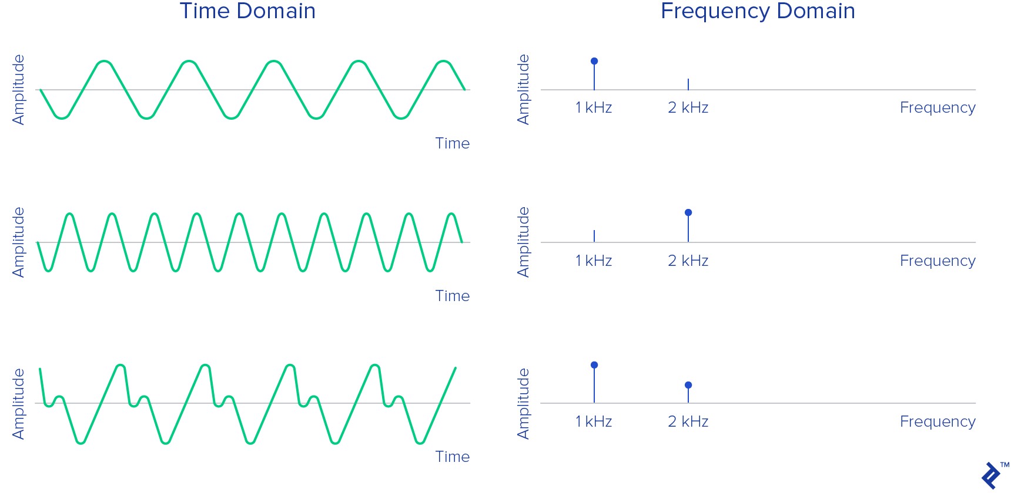
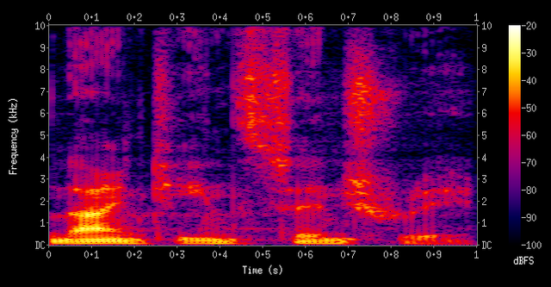
Why we need to learn about “Pattern matching”?

Slide 11
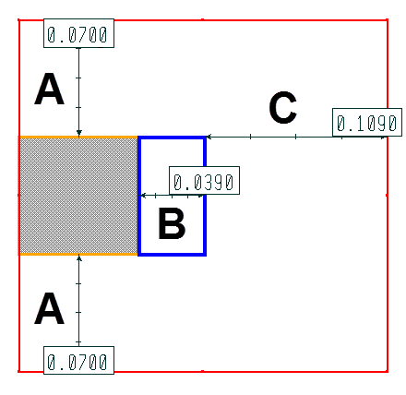
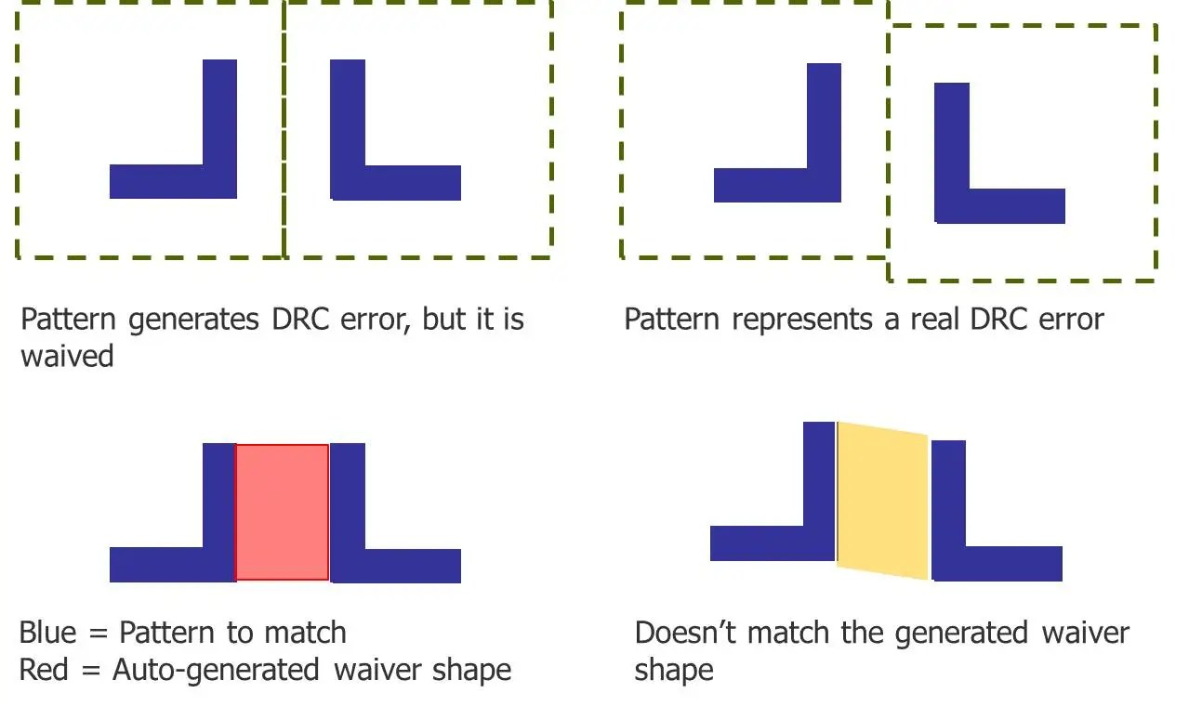
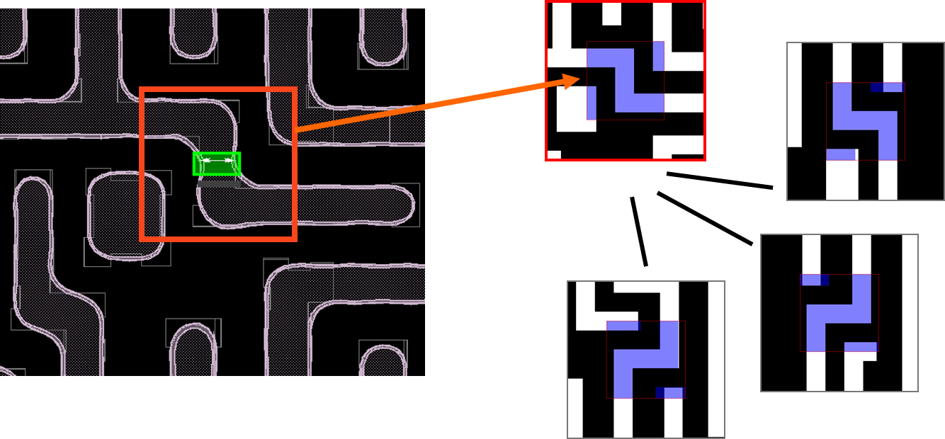
Why we need to learn about “Pattern matching”?

Slide 12
A Short History
Brute Force (Naive) algorithm – early 20th century
Knuth-Morris-Pratt algorithm – publish in 1976
Boyer-Moore algorithm – 1977
Aho-Corasick algorithm (1975)
Rabin-Karp fingerprint search algorithm – 1980
Wu-Manber algorithm (1992)

Slide 13

Substring Search Algorithms
02.
Substring Search Algorithms
2.1 Brute – Force
2.2 Knuth – Morris – Pratt
2.3 Boyer – Moore
2.4 Rabin Karp

Slide 14
2.1
Brute – Force

Slide 15
2.1 Brute – Force
The Brute-Force algorithm is a naive string-matching algorithm that involves comparing each character of a given pattern to each character of a text one-by-one.
Idea:
A pointer (i) into the text(length = N) and a pointer (j) into the pattern (length = M)
For each i, resets j to 0 and increments j until finding a mismatch or the end of the pattern (j == M).
(j == M) => return i => the pattern occur in the text
If i reach the end of the text (i == N-M+1) and then there is no match.
=>Return N to indicate a mismatch => the pattern does not occur in the text
Example:
0 | 1 | 2 | 3 | 4 | 5 | 6 | 7 | 8 | 9
A | B | A | C | A | D | A | B | R | A
Text
Pattern
A
B
R
A

Slide 16
2.1 Brute – Force
Visualization
N | M | N-M+1
10 | 4 | 7
0 | 1 | 2 | 3 | 4 | 5 | 6 | 7 | 8 | 9
A | B | A | C | A | D | A | B | R | A
i
j
i+j
Text
0
2
2
Pattern
A
B
R
A
A
B
R
A
A
B
R
A
1
0
1
A
B
R
A
2
1
3
A
B
R
A
A
B
R
A
3
0
3
A
B
R
A
j = M = 4
A
B
R
A
4
1
5
A
B
R
A
A
B
R
A
Return i=6
5
0
5
A
B
R
R
A
A
B
A
6
4
10
A
B
R
A
the pattern occur in the text
A
B
R
A

Slide 17
2.1 Brute – Force
Visualization
N | M | N-M+1
10 | 4 | 7
0 | 1 | 2 | 3 | 4 | 5 | 6 | 7 | 8 | 9
A | B | A | C | A | D | A | B | R | A
i
j
i+j
Text
R
0
2
2
Pattern
A
B
R
A
A
B
R
A
A
A
B
R
R
A
1
0
1
B
A
2
1
3
A
B
R
A
A
B
R
A
i=(N-M+1)
j !=( M = 4)
3
0
3
A
R
A
A
B
R
A
B
4
1
5
A
A
A
B
R
A
B
R
Return N=10
5
0
5
A
B
A
A
B
R
A
R
6
3
9
A
B
R
A
the pattern does not
occur in the text
A
B
R
A
7

Slide 18
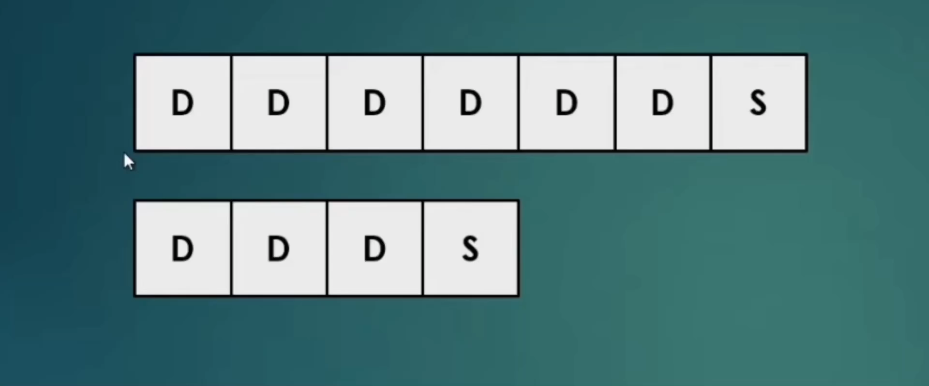
2.1 Brute – Force
Drawback
Main problem: needs back up for every mismatch.
Not so efficient especially when there are lots of matching prefixes.
For example: pattern is DDDS and the text is DDDDDDS
Lots of compares: ~N*M where N is length of text, M is length of the pattern.
Linear time guarantee would be better.
Notes:
Total cost: M*(N-M+1)
Such degenerate strings are not likely to appear in English text, but they may well occur in other applications (for example, in binary texts), so we seek better algorithms.
Brute-force search is easy to implement and works well in typical cases

Slide 19

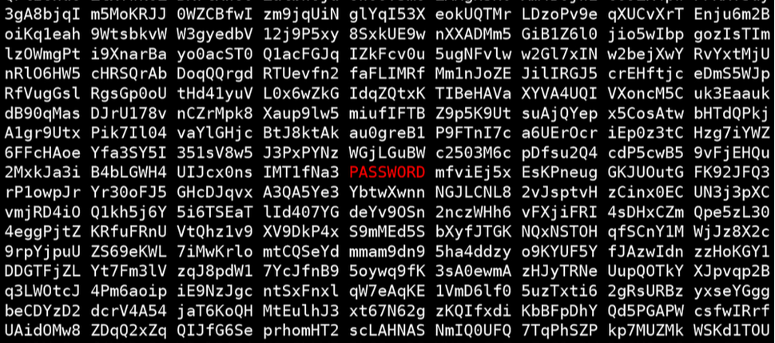
2.1 Brute – Force

Slide 20
2.2
Knuth-Morris-Pratt
Notes:
Thiếu phần chi phí

Slide 21

Dr. Donald Ervin Knuth

Slide 22

Dr. Vaughan Pratt

Slide 23
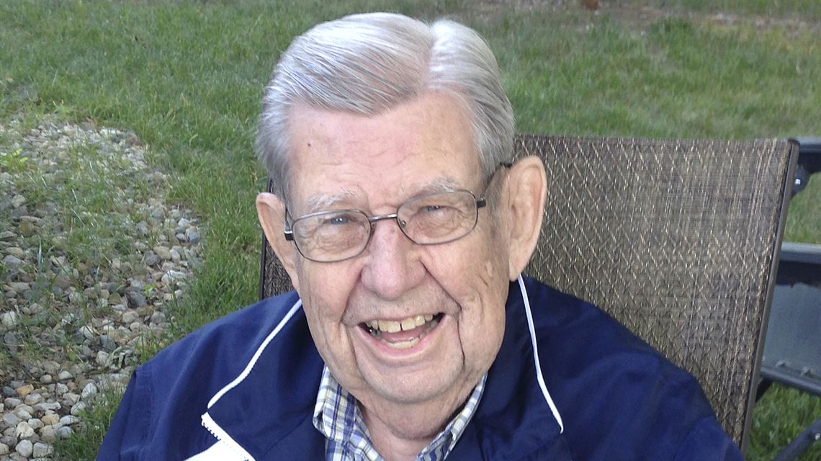
Dr. James Hiram Morris

Slide 24
The KMP Algorithm
A | B | A | A | A | A | B | A | A | A | A | A | A | A | A | A
B | A | A | A | A | A | A | A | A | A
Can we do better?
B | A | A | A | A | A | A | A | A | A
B | A | A | A | A | A | A | A | A | A
B | A | A | A | A | A | A | A | A | A
B | A | A | A | A | A | A | A | A | A
B | A | A | A | A | A | A | A | A | A
Idea:
Whenever we detect a mismatch, we already know some of the characters in the text
We can take advantage of this information to avoid backing up the text pointer over all those known characters.
Notes:
Thêm nội dung cho KMP

Slide 25
The KMP Algorithm
Text
A | A | B | A | A | B | A | A | A | A
A
A
A
A
A | A | B | A | A | A
Pattern
A
B
Not found
→ Fully skipping past all the matched characters when detecting a mismatch will not work when the pattern could match itself at any position overlapping the point of the mismatch.
Notes:
- We first detect the mismatch at position 5, but we had better restart at position 3 to continue the search. Otherwise, we would miss the match
→ Fully skipping past all the matched characters when detecting a mismatch will not work when the pattern could match itself at any position overlapping the point of the mismatch.

Slide 26
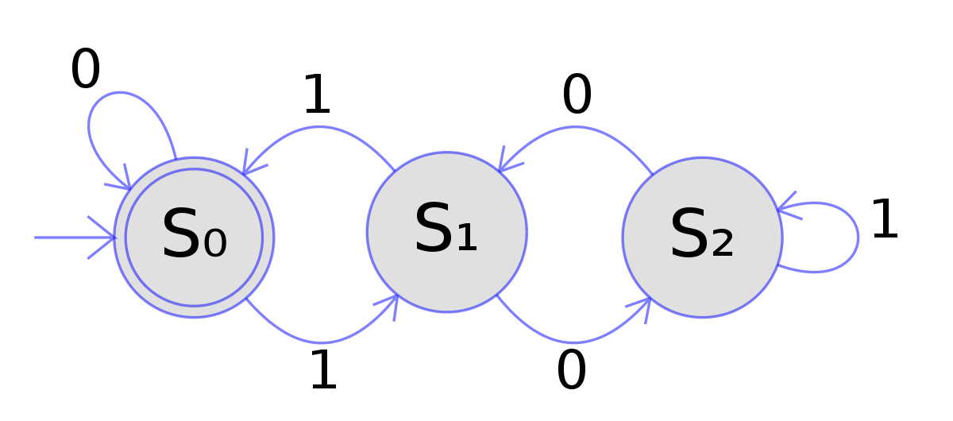
The KMP Algorithm
- We can use a DFA (deterministic finite-state automaton) to simulate the process.
- So, what exactly does the DFA do?

Slide 27
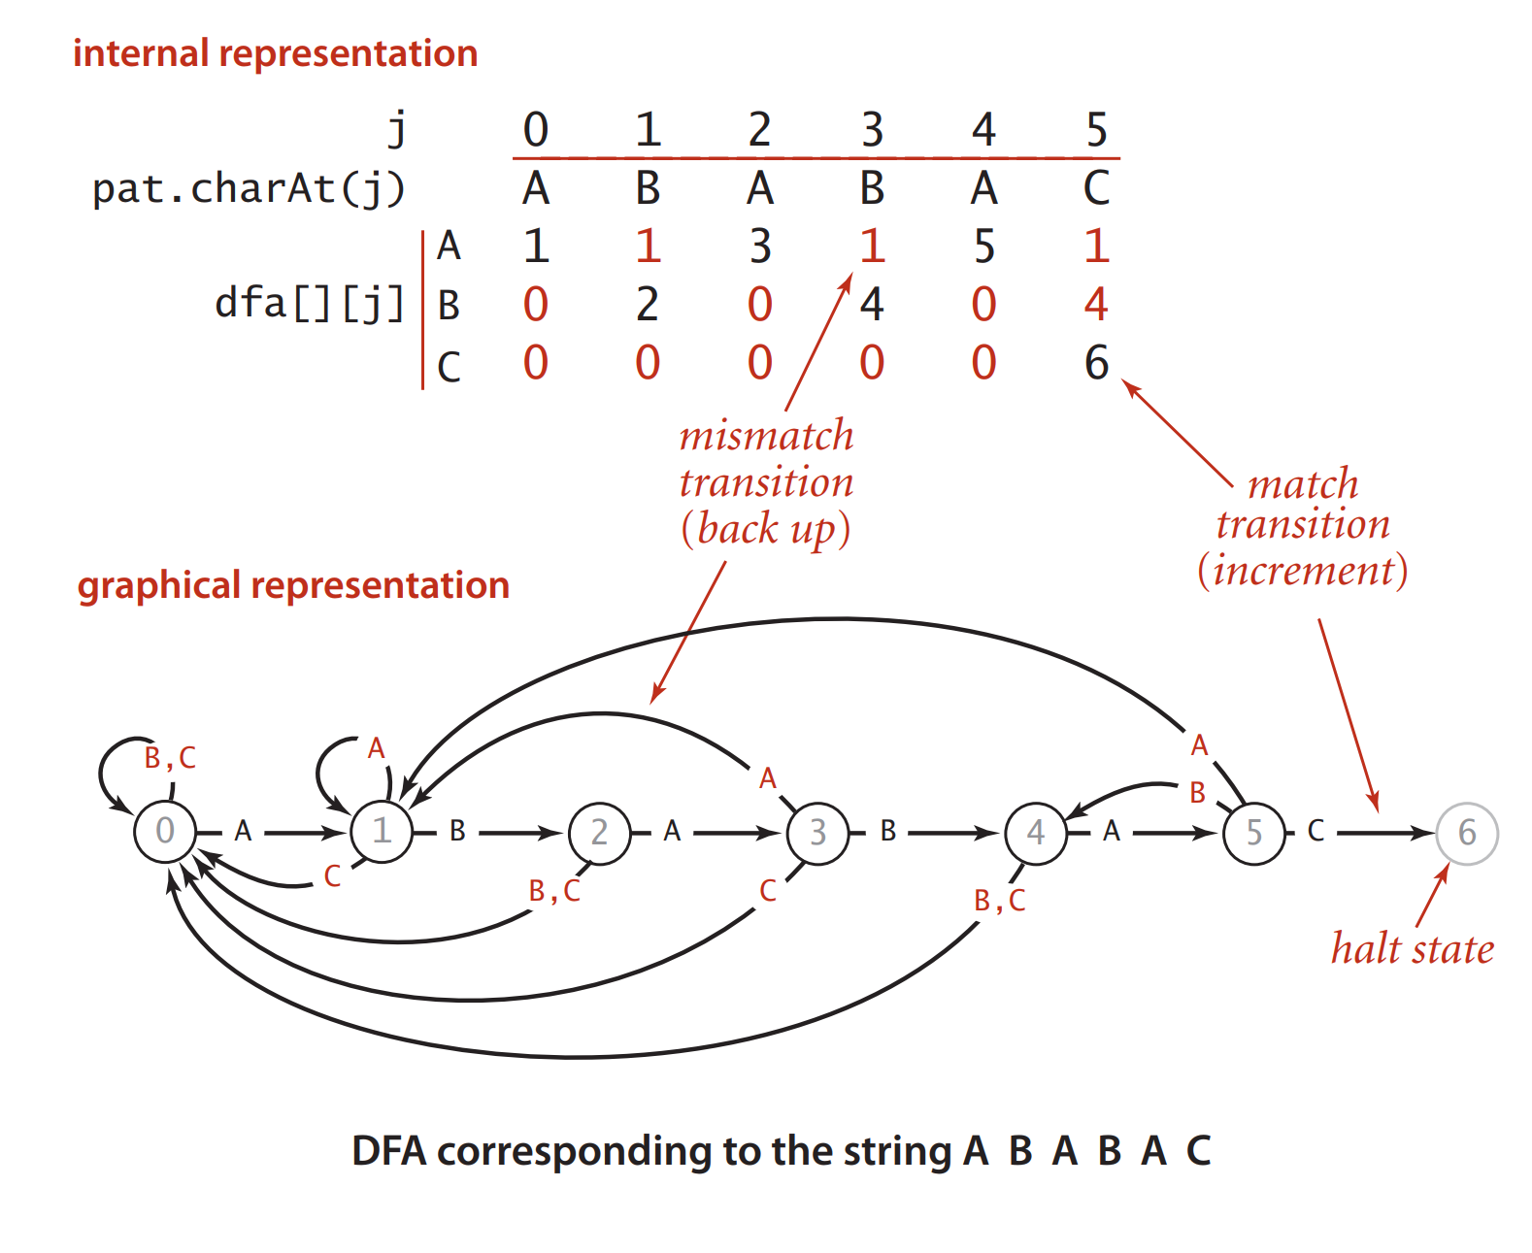
The KMP Algorithm
DFA simulation:

Slide 28
The KMP Algorithm
DFA simulation:
j | 0 | 1 | 2 | 3 | 4 | 5
Pat.char(j) | A | B | A | B | A | C
Internal representation
1
dfa[][j] | A
 | B
 | C
1
1
3
5
1
0
2
0
4
0
4
0
0
0
0
0
6
Graphical representation
B, C
A
A
A
0
A
1
B
2
A
3
B
4
A
5
C
6
C
B, C
B
C
B, C
DFA corresponding to the string ABABAC

Slide 29
The KMP Algorithm
DFA simulation:
i | 0 | 1 | 2 | 3 | 4 | 5 | 6 | 7 | 8 | 9 | 10 | 11 | 12 | 13 | 14 | 15 | 16
Txt.charAt(i) | B | C | B | A | A | B | A | C | A | A | B | A | B | A | C | A | A
0
0
0
0
1
1
2
3
0
1
1
2
3
4
5
6
6
Mismatch:
Set j to dfa[ txt.CharAt(i)] [ j ]
implies pattern shift to align
pat.CharAt(j) with txt.charAt(i+1)
A | B | A | B | A | C
A
the pattern found
A
A | B | A | B | A | C
Match:
Set j to dfa[txt.charAt(i)][j]
=dfa[pat.charAt(i)][j]
= j+1
A | B | A | B | A | C
A
A
Return i - M=15 – 6 = 9
A | B | A | B | A | C
B
A
A
B
A | B | A | B | A | C
dfa[][j] | A | 1 | 1 | 3 | 1 | 5 | 1
 | B | 0 | 2 | 0 | 4 | 0 | 4
 | C | 0 | 0 | 0 | 0 | 0 | 6
B
A | B | A | B | A | C
A
B
C
A | B | A | B | A | C
A
B
A
B
A
Trace of KMP substring search (DFA simulation) for ABABAC
Notes:
In KMP substring search:
+) We never backup the text pointer i
+) Use an array dfa[][] to record how far to back up the pattern pointer j when a mismatch is detected.

Slide 30
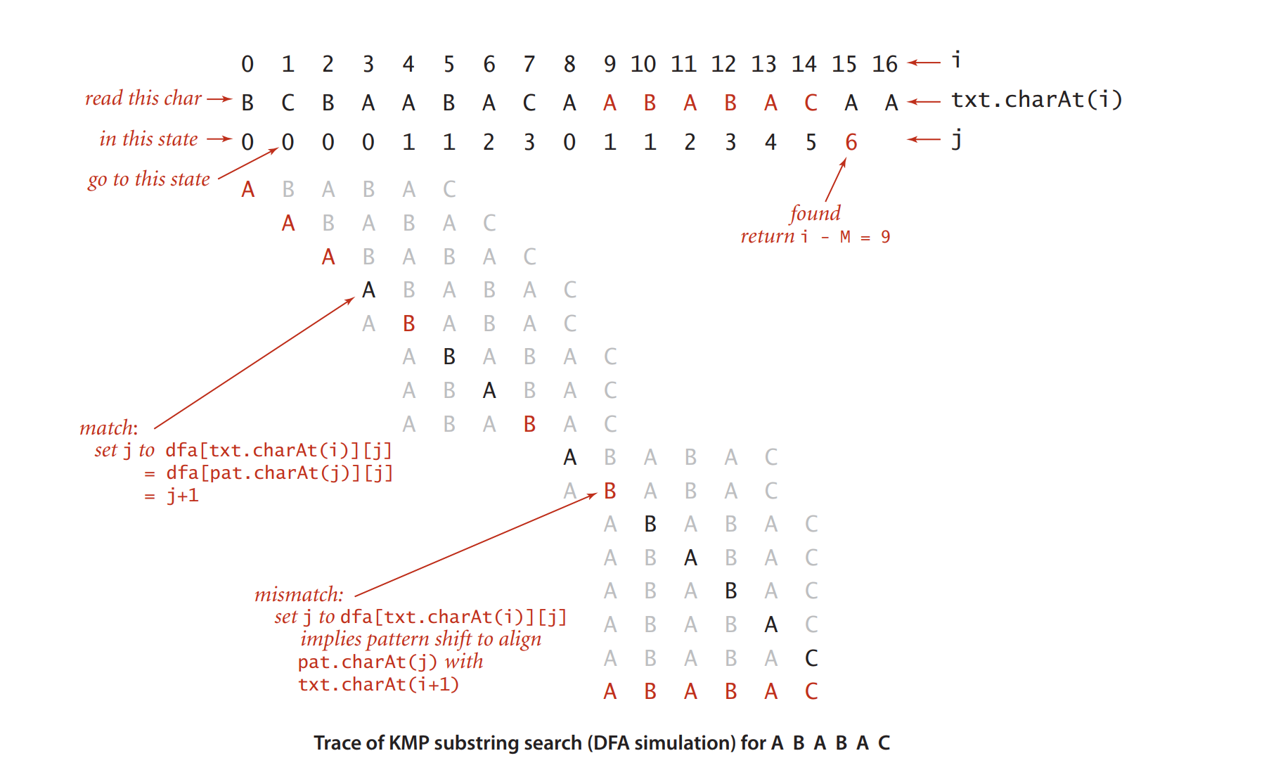
The KMP Algorithm
DFA simulation:
Notes:
In KMP substring search:
+) We never backup the text pointer i
+) Use an array dfa[][] to record how far to back up the pattern pointer j when a mismatch is detected.

Slide 31
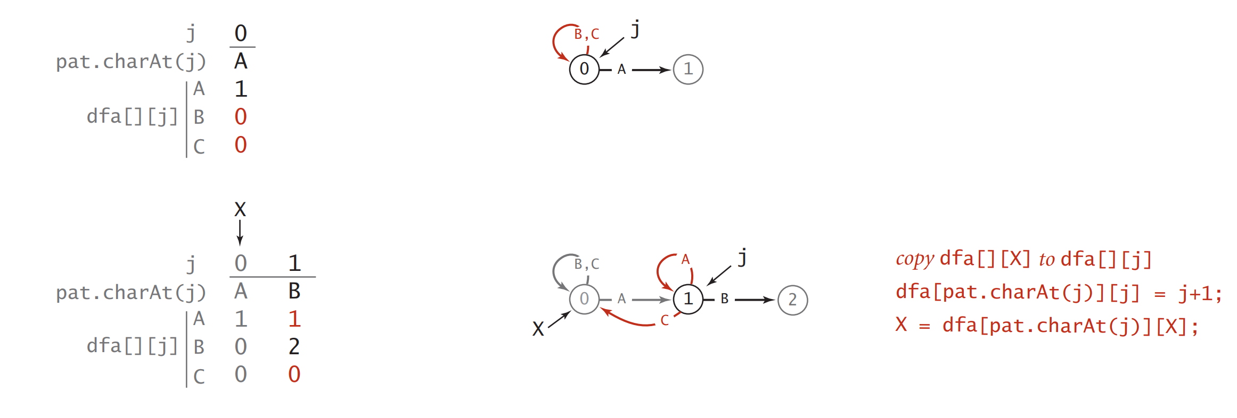
The KMP Algorithm
How to construct the DFA?
Notes:
For each j, it ■ Copies dfa[][X] to dfa[][j] (for mismatch cases) ■ Sets dfa[pat.charAt(j)][j] to j+1 (for the match case) ■ Updates X

Slide 32
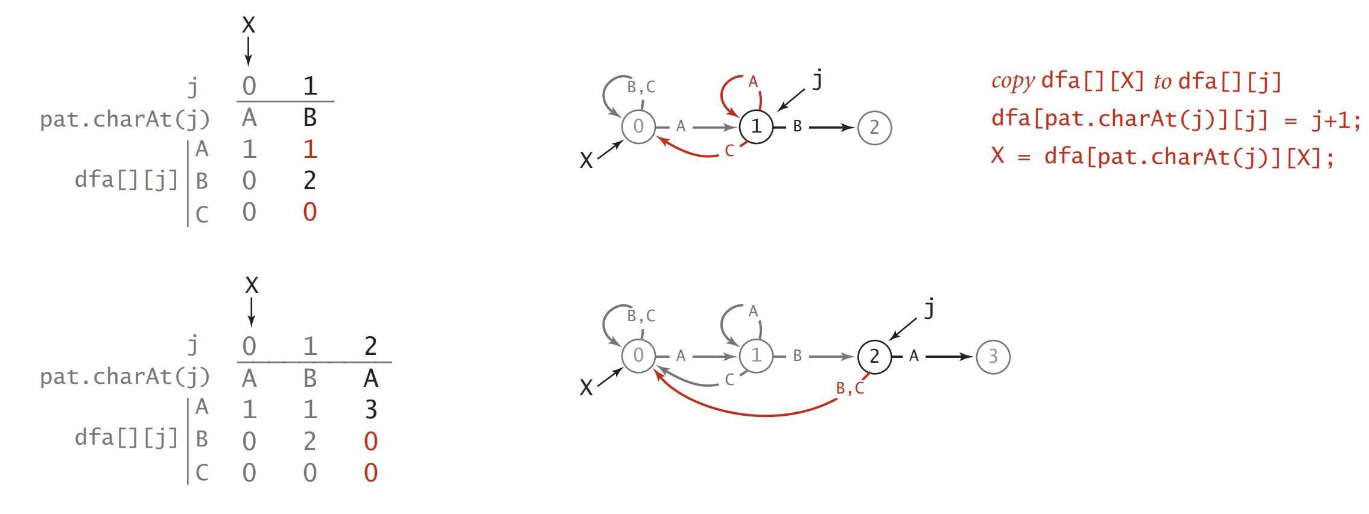
The KMP Algorithm
How to construct the DFA?
Notes:
For each j, it ■ Copies dfa[][X] to dfa[][j] (for mismatch cases) ■ Sets dfa[pat.charAt(j)][j] to j+1 (for the match case) ■ Updates X

Slide 33
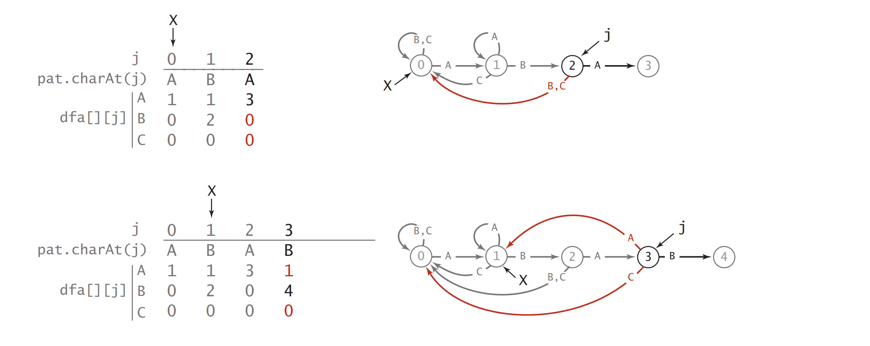
The KMP Algorithm
How to construct the DFA?
Notes:
For each j, it ■ Copies dfa[][X] to dfa[][j] (for mismatch cases) ■ Sets dfa[pat.charAt(j)][j] to j+1 (for the match case) ■ Updates X

Slide 34
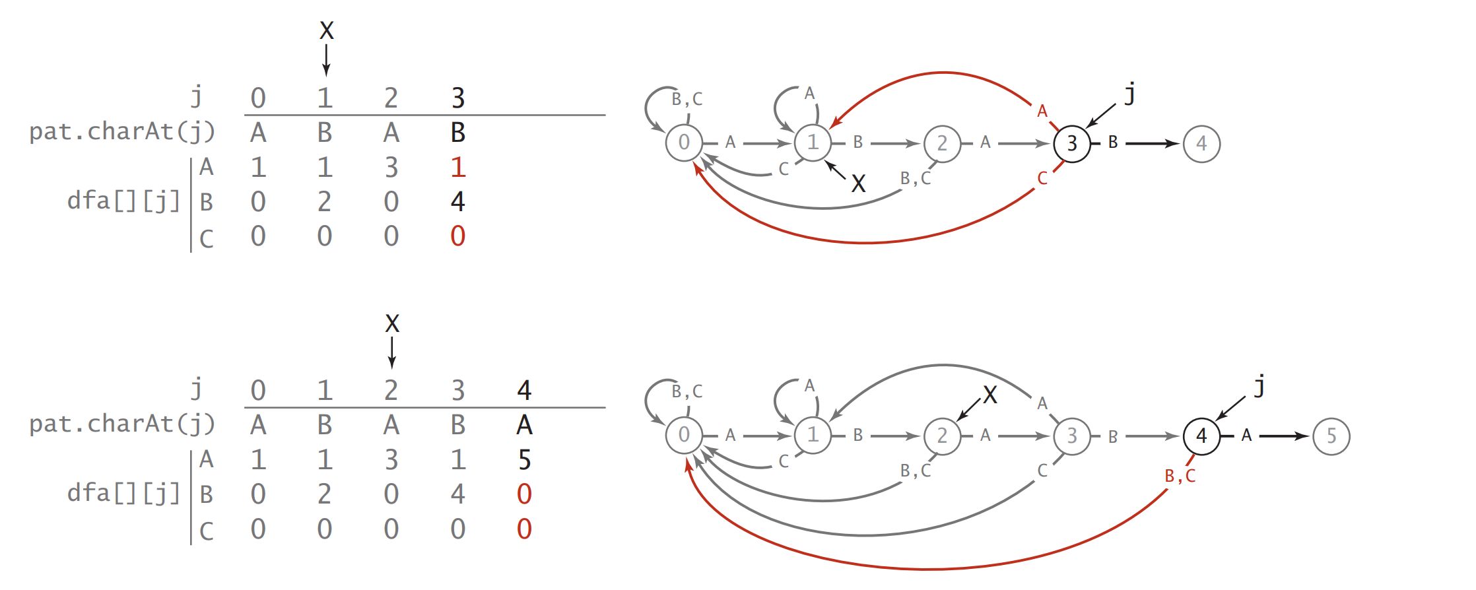
The KMP Algorithm
How to construct the DFA?
Notes:
For each j, it ■ Copies dfa[][X] to dfa[][j] (for mismatch cases) ■ Sets dfa[pat.charAt(j)][j] to j+1 (for the match case) ■ Updates X

Slide 35
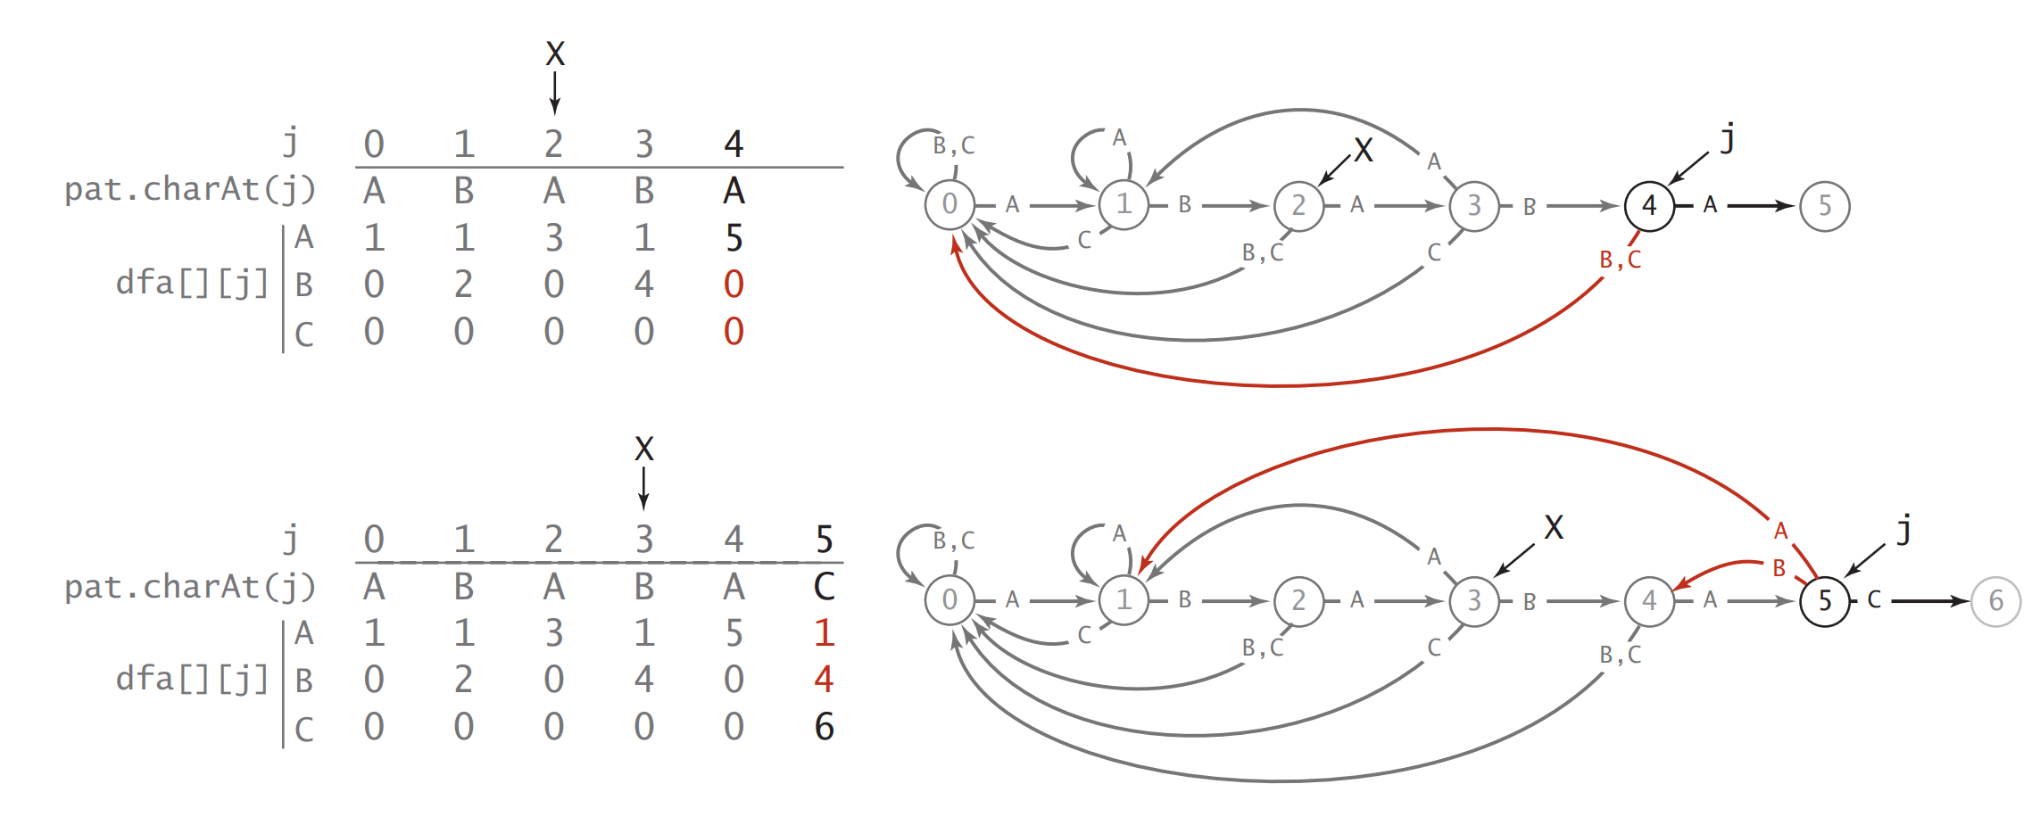
The KMP Algorithm
Pros
How to construct the DFA?
Cons
Notes:
For each j, it ■ Copies dfa[][X] to dfa[][j] (for mismatch cases) ■ Sets dfa[pat.charAt(j)][j] to j+1 (for the match case) ■ Updates X

Slide 36

The KMP Algorithm
Pros
Cons
It is guaranteed worst-case efficient, the preprocessing time is O(m) and the searching time is O(n).
Time and space for pre-processing stage (use extra space)
Complexity
The algorithm never needs to move backwards in the input text.
Limited use
Notes:
- Does the same job as the brute-force method, but it runs faster for patterns that are self-repetitive.
Time and space for pre-processing stage
Limited use: KMP algo is most effective for searching for a single pattern string in a text string, may not be a best choice for more complex string matching task, doesn’t work so well as the size of the alphabets increases (by which more chances of mismatch occurs).
More convenient for use on an input stream of undetermined length
Bc few applications involve searching for highly self-repetitive patterns in highly self-repetitive text. Still, the method works well on binary text.
Knuth-Morris-Pratt is guaranteed linear-time with no backup in the input
Knuth-Morris-Pratt and Boyer-Moore use extra space

Slide 37
2.3
Boyer-Moore
Notes:
Thiếu dẫn đầu, chi phí,

Slide 38
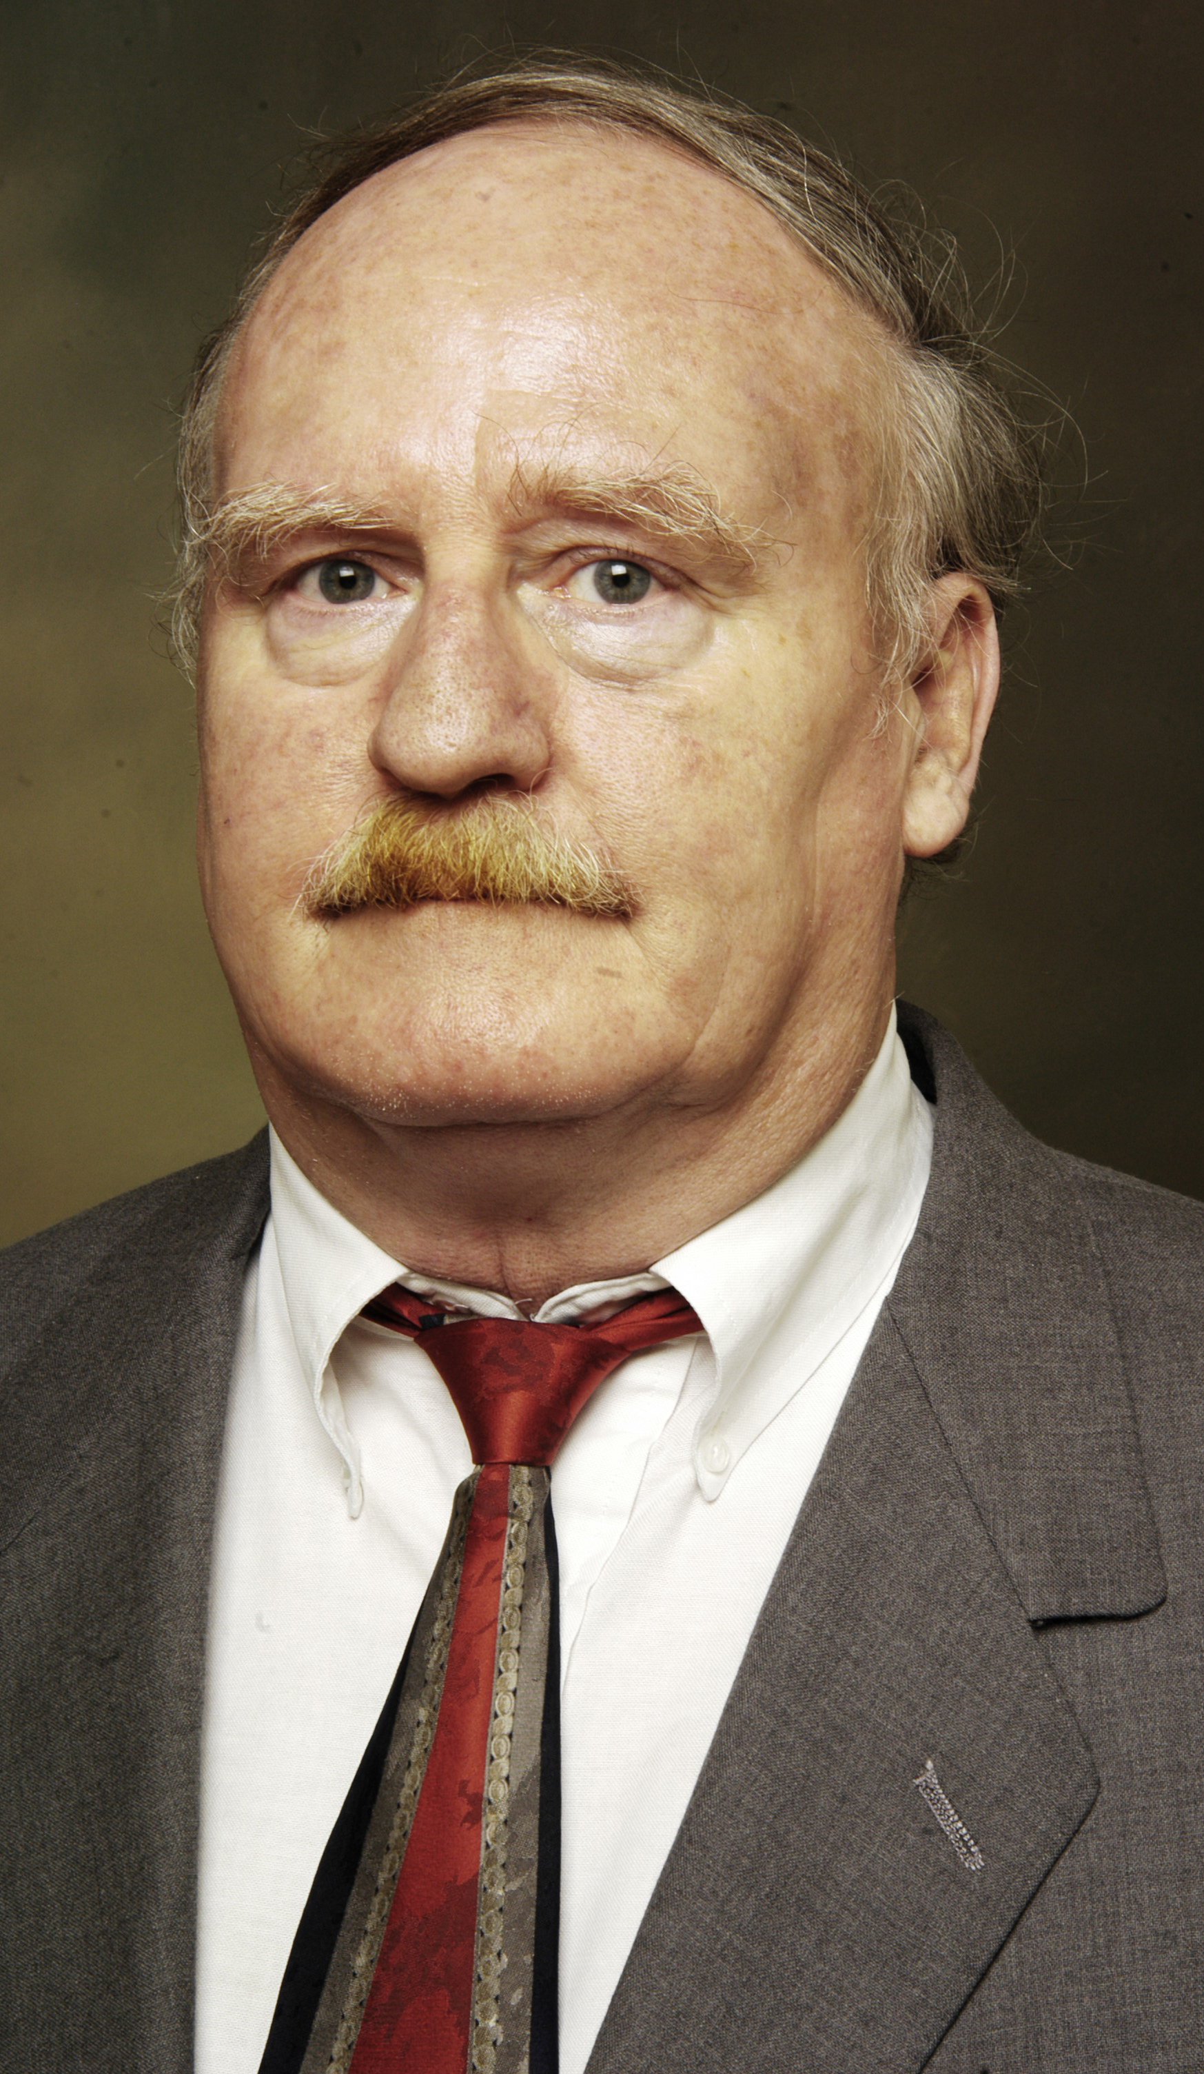
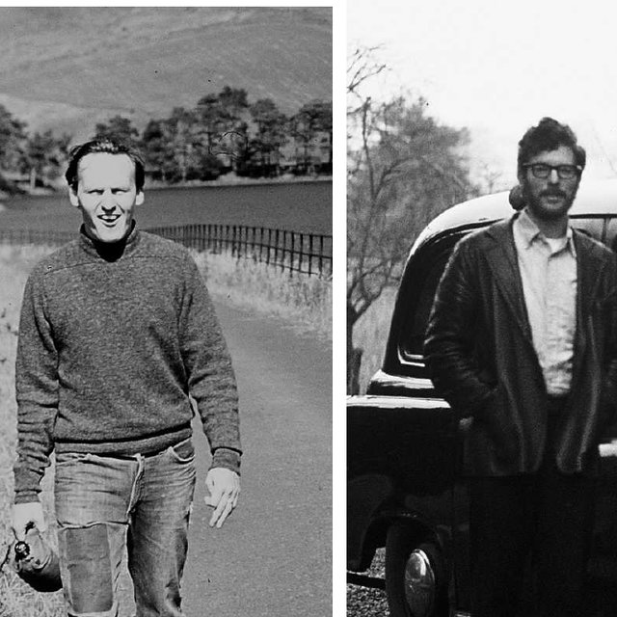

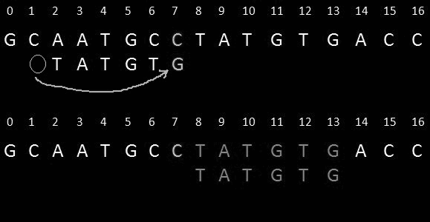
Dr. Robert Stephen Boyer (left) & Dr. J Strother Moore (right)

Slide 39
The Boyer-Moore Algorithm
The Boyer-Moore’s pattern matching algorithm is based on two heuristics
Looking-glass heuristic: Scanning the pattern from right to left.
Character-jump heuristic: Skipping as many characters as possible by using information from the pattern itself.
Example:
Text:
F | I | N | D | I | N | A | H | A | Y | S | T | A | C | K | N | E | E | D | L | E
Pattern:
N | E | E | D | L | E
Notes:
- When backup in the text string is not a problem

Slide 40
The Boyer-Moore Algorithm
F | I | N | D | I | N | A | H | A | Y | S | T | A | C | K | N | E | E | D | L | E
N
N | E | E | D | L | E
E

Slide 41
The Boyer-Moore Algorithm
F | I | N | D | I | N | A | H | A | Y | S | T | A | C | K | N | E | E | D | L | E
S
N | E | E | D | L | E
E

Slide 42
The Boyer-Moore Algorithm
N
F | I | N | D | I | N | A | H | A | Y | S | T | A | C | K | N | E | E | D | L | E
E
N | E | E | D | L | E
L
E

Slide 43
The Boyer-Moore Algorithm
F | I | N | D | I | N | A | H | A | Y | S | T | A | C | K | N | E | E | D | L | E
N
E
E
D
L
E
N | E | E | D | L | E
N
E
E
D
L
E
Notes:
Vũ Sửa Slide

Slide 44
The Boyer-Moore Algorithm
- Boyer-Moore skip table computation
N | E | E | D | L | E
c |  | 0 | 1 | 2 | 3 | 4 | 5 | right[c]
A | -1 | -1 | -1 | -1 | -1 | -1 | -1 | -1
B | -1 | -1 | -1 | -1 | -1 | -1 | -1 | -1
C | -1 | -1 | -1 | -1 | -1 | -1 | -1 | -1
D | -1 | -1 | -1 | -1 | 3 | 3 | 3 | 3
E | -1 | -1 | 1 | 2 | 2 | 2 | 5 | 5
… | … | … | … | … | … | … | … | -1
L | -1 | -1 | -1 | -1 | -1 | 4 | 4 | 4
M | -1 | -1 | -1 | -1 | -1 | -1 | -1 | -1
N | -1 | 0 | 0 | 0 | 0 | 0 | 0 | 0
… | … | … | … | … | … | … | … | -1
Notes:
we use an array right[] that gives, for each character in the alphabet, the index of its rightmost occurrence in the pattern (or -1 if the character is not in the pattern)

Slide 45
The Boyer-Moore Algorithm
Pros
Cons
Substring search (in Boyer-Moore algorithm):
+) If txt.charAt(i + j) is equal to pat.charAt(j) for all j from M – 1 down to 0, then there is a match.
+) If there is a mismatch:
If the character causing the mismatch is not found in the pattern, slide the pattern j + 1 positions to the right
If the character c causing the mismatch is found in the pattern, use right[] array to line up the pattern with the text, so that the character will match its rightmost occurrence in the pattern (i += (j – right[c]))
If this computation would not increase i, we just increment i instead.
+) Efficient: works particularly well for
long search patterns, and it can be
sub-linear
+) Considered the most efficient
string-matching algorithm in usual
application, such as, in text editors and
command substitutions.
+) Not as good for binary strings or for
very short patterns.
+) Worst-case time complexity: can be
O(M*N) in certain cases.
Notes:
we use an array right[] that gives, for each character in the alphabet, the index of its rightmost occurrence in the pattern (or -1 if the character is not in the pattern)

Slide 46
The Boyer-Moore Algorithm
Pros
Cons
+) Efficient: works particularly well for
long search patterns, and it can be
sub-linear
+) Considered the most efficient
string-matching algorithm in usual
application, such as, in text editors and
command substitutions.
+) Not as good for binary strings or for
very short patterns.
+) Worst-case time complexity: can be
O(M*N) in certain cases.
Notes:
Boyer-Moore is sublinear (by a factor of M) in typical situations

Slide 47
2.4
Rabin-Karp

Slide 48
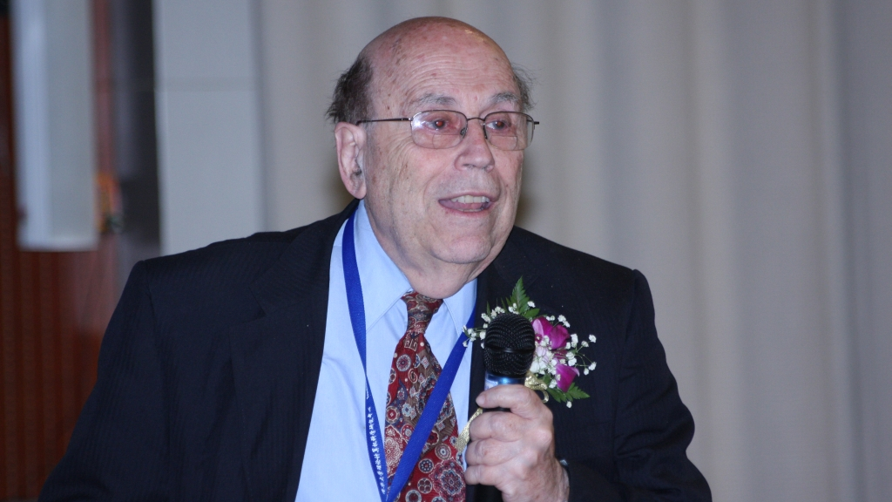
Dr. Michael Oser Rabin

Slide 49
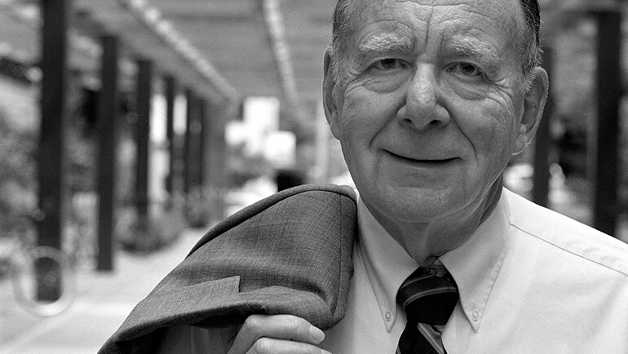
Dr. Richard Manning Karp

Slide 50
The Rabin-Karp Algorithm
The method is developed by M.O.Rabin and R.A.Karp:
Approach: Based on hashing
How it works?:
If we find a text substring with the same hash value as the pattern → check for a match
Do a search for each substring of the text till finding → If not found, we can lead to the conclusion that the pattern does not exist in the text
Example:
pat.charAt(j)
j | 0 | 1 | 2 | 3 | 4
 | 2 | 6 | 5 | 3 | 5
txt.charAt(j)
i | 0 | 1 | 2 | 3 | 4 | 5 | 6 | 7 | 8 | 9 | 10 | 11 | 12 | 13 | 14 | 15
 | 3 | 1 | 4 | 1 | 5 | 9 | 2 | 6 | 5 | 3 | 5 | 8 | 9 | 7 | 9 | 3

Slide 51
The Rabin-Karp Algorithm
pat.charAt(j)
j | 0 | 1 | 2 | 3 | 4
 | 2 | 6 | 5 | 3 | 5
% 997 =
613
txt.charAt(j)
i | 0 | 1 | 2 | 3 | 4 | 5 | 6 | 7 | 8 | 9 | 10 | 11 | 12 | 13 | 14 | 15
 | 3 | 1 | 4 | 1 | 5 | 9 | 2 | 6 | 5 | 3 | 5 | 8 | 9 | 7 | 9 | 3
0
3 | 1 | 4 | 1 | 5
% 997 =
508
Notes:
Vũ

Slide 52
The Rabin-Karp Algorithm
pat.charAt(j)
j | 0 | 1 | 2 | 3 | 4
 | 2 | 6 | 5 | 3 | 5
% 997 =
613
txt.charAt(j)
i | 0 | 1 | 2 | 3 | 4 | 5 | 6 | 7 | 8 | 9 | 10 | 11 | 12 | 13 | 14 | 15
 | 3 | 1 | 4 | 1 | 5 | 9 | 2 | 6 | 5 | 3 | 5 | 8 | 9 | 7 | 9 | 3
1
1 | 4 | 1 | 5 | 9
% 997 =
201

Slide 53
The Rabin-Karp Algorithm
pat.charAt(j)
j | 0 | 1 | 2 | 3 | 4
 | 2 | 6 | 5 | 3 | 5
% 997 =
613
txt.charAt(j)
i | 0 | 1 | 2 | 3 | 4 | 5 | 6 | 7 | 8 | 9 | 10 | 11 | 12 | 13 | 14 | 15
 | 3 | 1 | 4 | 1 | 5 | 9 | 2 | 6 | 5 | 3 | 5 | 8 | 9 | 7 | 9 | 3
2
4 | 1 | 5 | 9 | 2
% 997 =
715

Slide 54
The Rabin-Karp Algorithm
pat.charAt(j)
j | 0 | 1 | 2 | 3 | 4
 | 2 | 6 | 5 | 3 | 5
% 997 =
613
txt.charAt(j)
i | 0 | 1 | 2 | 3 | 4 | 5 | 6 | 7 | 8 | 9 | 10 | 11 | 12 | 13 | 14 | 15
 | 3 | 1 | 4 | 1 | 5 | 9 | 2 | 6 | 5 | 3 | 5 | 8 | 9 | 7 | 9 | 3
3
1 | 5 | 9 | 2 | 6
% 997 =
971

Slide 55
The Rabin-Karp Algorithm
pat.charAt(j)
j | 0 | 1 | 2 | 3 | 4
 | 2 | 6 | 5 | 3 | 5
% 997 =
613
txt.charAt(j)
i | 0 | 1 | 2 | 3 | 4 | 5 | 6 | 7 | 8 | 9 | 10 | 11 | 12 | 13 | 14 | 15
 | 3 | 1 | 4 | 1 | 5 | 9 | 2 | 6 | 5 | 3 | 5 | 8 | 9 | 7 | 9 | 3
4
5 | 9 | 2 | 6 | 5
% 997 =
442

Slide 56
The Rabin-Karp Algorithm
pat.charAt(j)
j | 0 | 1 | 2 | 3 | 4
 | 2 | 6 | 5 | 3 | 5
% 997 =
613
txt.charAt(j)
i | 0 | 1 | 2 | 3 | 4 | 5 | 6 | 7 | 8 | 9 | 10 | 11 | 12 | 13 | 14 | 15
 | 3 | 1 | 4 | 1 | 5 | 9 | 2 | 6 | 5 | 3 | 5 | 8 | 9 | 7 | 9 | 3
5
9 | 2 | 6 | 5 | 3
% 997 =
929

Slide 57
The Rabin-Karp Algorithm
pat.charAt(j)
j | 0 | 1 | 2 | 3 | 4
 | 2 | 6 | 5 | 3 | 5
% 997 =
613
txt.charAt(j)
i | 0 | 1 | 2 | 3 | 4 | 5 | 6 | 7 | 8 | 9 | 10 | 11 | 12 | 13 | 14 | 15
 | 3 | 1 | 4 | 1 | 5 | 9 | 2 | 6 | 5 | 3 | 5 | 8 | 9 | 7 | 9 | 3
2 | 6 | 5 | 3 | 5
6
2 | 6 | 5 | 3 | 5
% 997 =
613
→ Pattern found!!!

Slide 58
The Rabin-Karp Algorithm
What if M is 100 or 1000?
Notation:
+) A string of length M corresponds to an M-digit base-R number
+) Use a hash table of size Q. In practice, we use a random prime Q.
Use Horner’s method, which computes the hash function for an M-digit base-R number represented as a char array in time proportional to M.
Notes:
- Rabin and Karp showed that it is easy to compute hash functions for M-character substrings in constant time (after some preprocessing), which leads to a linear-time substring search in practical situations. - With five-digit values, we could just do all the necessary calculations with int values, but what do we do when M is 100 or 1,000? - The same method (Horner’s) can work for computing the hash functions in the text, but the cost for the substring search would be a multiplication, addition, and remainder calculation for each text character, for a total of NM operations in the worst case, no improvement over the brute-force method.

Slide 59
The Rabin-Karp Algorithm
pat.charAt(j)
i | 0 | 1 | 2 | 3 | 4
 | 2 | 6 | 5 | 3 | 5
0 | 2 | % 997 = 2
1 | 2 | 6 | % 997 = (2 * 10 + 6) % 997 = 26
2 | 2 | 6 | 5 | % 997 = (26 * 10 + 5) % 997 = 265
3 | 2 | 6 | 5 | 3 | % 997 = (265 * 10 + 3) % 997 = 659
4 | 2 | 6 | 5 | 3 | 5 | % 997 = (265 * 10 + 3) % 997 = 659
Computing the hash value for the pattern with Horner’s method

Slide 60
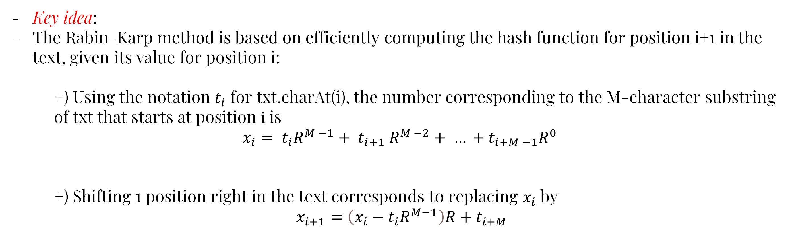
The Rabin-Karp Algorithm
Key idea:
The Rabin-Karp method is based on efficiently computing the hash function for position i+1 in the text, given its value for position i:
+) Using the notation $t_{i}$ for txt.charAt(i), the number corresponding to the M-character substring of txt that starts at position $ⅈ$ is
$$x_{i}= t_{i}R^{M −1}+ t_{i+1} R^{M −2}+ … +t_{i+M −1}R^{0}$$
+) Shifting 1 position right in the text corresponds to replacing $x_{i}$ by
$$x_{i+1}=\left(x_{i}−t_{i}R^{M−1}\right)R+t_{i+M}$$

Slide 61

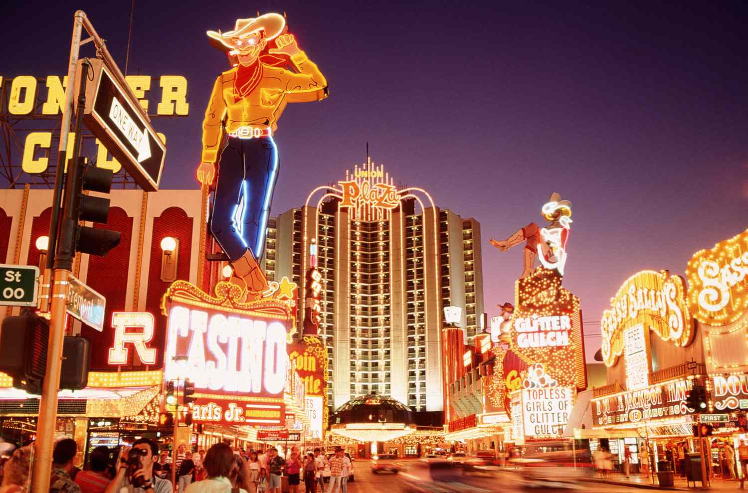
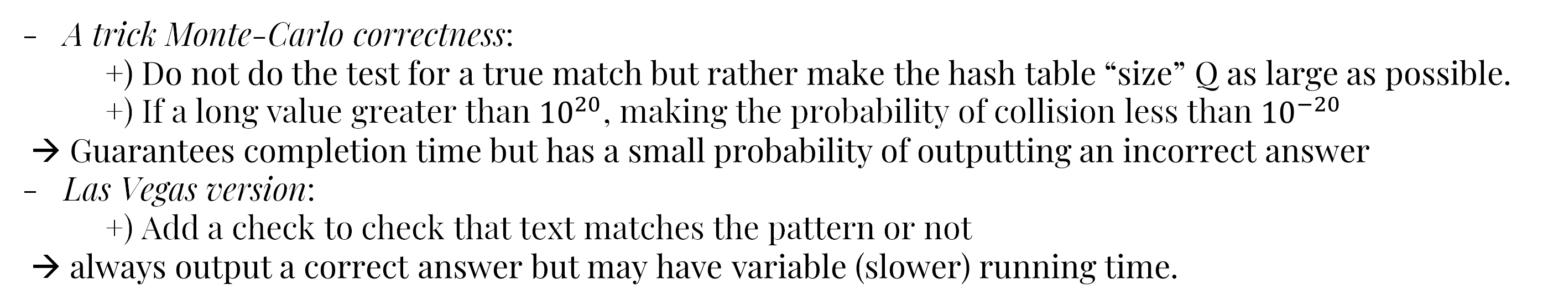
The Rabin-Karp Algorithm
A trick Monte-Carlo correctness:
+) Do not do the test for a true match but rather make the hash table “size” Q as large as possible.
+) If a long value greater than ${10}^{20}$, making the probability of collision less than ${10}^{−20}$
→ Guarantees completion time but has a small probability of outputting an incorrect answer
Las Vegas version:
+) Add a check to check that text matches the pattern or not
→ always output a correct answer but may have variable (slower) running time.
Notes:
- Instead, we make the hash table “size” Q as large as we wish, since we are not actually building a hash table, just testing for a collision with one key, our pattern.
The Monte Carlo version of Rabin-Karp substring search is linear-time and extremely likely to be correct, and the Las Vegas version of Rabin-Karp substring search is correct and extremely likely to be linear-time
Theoretically, a text position could lead to a hash collision and not a substring match, but in practice it can be relied upon to find a match.

Slide 62
The Rabin-Karp Algorithm
i | 0 | 1 | 2 | 3 | 4 | 5 | 6 | 7 | 8 | 9 | 10 | 11 | 12 | 13 | 14 | 15
 | 3 | 1 | 4 | 1 | 5 | 9 | 2 | 6 | 5 | 3 | 5 | 8 | 9 | 7 | 9 | 3
0 | 3 | % 997 = 3
1 | 3 | 1 | % 997 = (3 * 10 + 1) % 997 = 31
2 | 3 | 1 | 4 | % 997 = (31 * 10 + 4) % 997 = 314
3 | 3 | 1 | 4 | 1 | % 997 = (314 * 10 + 1) % 997 = 150
4 | 3 | 1 | 4 | 1 | 5 | % 997 = ( 3141 * 10 + 5) % 997 = 508
Notes:
Hiện từng dòng theo thứ tự sau mỗi lần click

Slide 63
The Rabin-Karp Algorithm
i | 0 | 1 | 2 | 3 | 4 | 5 | 6 | 7 | 8 | 9 | 10 | 11 | 12 | 13 | 14 | 15
 | 3 | 1 | 4 | 1 | 5 | 9 | 2 | 6 | 5 | 3 | 5 | 8 | 9 | 7 | 9 | 3
5
1 | 4 | 1 | 5 | 9 | % 997 = ((508 + 3 * (997 – 30)) * 10 + 9) % 997 = 201
6
4 | 1 | 5 | 9 | 2 | % 997 = ((201 + 1 * (997 – 30)) * 10 + 2) % 997 = 715
7
1 | 5 | 9 | 2 | 6 | % 997 = ((715 + 4 * (997 – 30)) * 10 + 6) % 997 = 971
8
5 | 9 | 2 | 6 | 5 | % 997 = ((971 + 1 * (997 – 30)) * 10 + 5) % 997 = 442
9
9 | 2 | 6 | 5 | 3 | % 997 = ((442 + 5 * (997 – 30)) * 10 + 3) % 997 = 929
10
613
2 | 6 | 5 | 3 | 5 | % 997 = ((929 + 9 * (997 – 30)) * 10 + 5) % 997 =

Slide 64
The Rabin-Karp Algorithm
Pros
+) Slow worst-case behavior
+) Can be false-positive
(Monte-Carlo correctness)
+) Good average-case performance:
O(M + N)
+) Easy to implement
Cons
Advantages:
+) Good average-case performance: O(M + N)
+) Easy to implement
Disadvantages:
+) Slow worst-case behavior
+) Can be false-positive (Monte-Carlo correctness)
Notes:
Rabin-Karp substring search is known as a fingerprint search because it uses a small amount of information to represent a (potentially very large) pattern. Then it looks for this fingerprint (the hash value) in the text. The algorithm is efficient because the fingerprints can be efficiently computed and compared.
RabinKarp is linear.
Rabin-Karp has a relatively long inner loop (several arithmetic operations, as opposed to character compares in the other methods)
Maybe hashing allows for faster comparisons

Slide 65
Cost summary for substring search implementations
Algorithm | Version | Operation count |  | Backup in input? | Correct? | Extra space
 |  | Guarantee | Typical
Brute Force | __ | MN | 1.1N | yes | yes | 1
Knuth-Morris-Pratt | full DFA | 2N | 1.1N | no | yes | MR
 | mismatch transitions only | 3N | 1.1N | no | yes | M
Boyer-Moore | full algorithm | 3N | N/M | yes | yes | R
Boyer-Moore | mismatched char heuristic only | MN | N/M | yes | yes | R
Rabin-Karp | Monte Carlo | 7N | 7N | no | yes (*) | 1
 | Las Vegas | 7N(*) | 7N | yes | yes | 1
*: probabilistic guarantee, with uniform and independent hash function

Slide 66
Comparison
Algorithm | Preprocessing Time | Matching Time | Best Case Time | Worst Case Time | Space Required
Brute-Force | O(1) | O(mn) | O(n) | O(nm) | O(1)
Knuth-Morris-Pratt (KMP) | O(m) | O(n) | O(m+n) | O(m+n) | O(m)
Boyer-Moore | O(m + k) | O(n) | O(n/m) | O(mn) | O(m + k)
Rabin-Karp | O(m) | O(n) | O(n+m) | O(nm) | O(1)

Slide 67
Regular Expression
(Optional)

Slide 68
Describing pattern with Regex
Definition. A regular expression (RE) is either:
Empty
A single character
A regular expression enclosed in parentheses
Two or more concatenated regular expressions
Two or more regular expressions separated by the or operator (|)
A regular expression followed by the closure operator (*)

Slide 69
Describing pattern with Regex
Definition. Each RE represents a set of strings, defined as follows:
The RE | Representation
Empty RE | empty set of strings, with 0 elements
A character | set of strings with one element, itself.
RE enclosed in parentheses | the same set of strings as the RE without the parentheses
RE consisting of two concatenated REs | cross product of the sets of strings represented by the individual components
RE consisting of the or of two Res ( | ) | the union of the sets rep- resented by the individual components
RE consisting of the closure of an RE ( * ) | (the empty string) or the union of the sets represented by the concatenation of any number of copies of the RE

Slide 70
Describing pattern with Regex
Name or meaning | Notation | Example
Concatenation |  | A B
Or | | | A|B
Closure | * | A*
Parentheses | Enclosed in () | (A|B)*C
Wildcard | . | A.B
Specified set | Enclosed [] | [ARIOU]*
Range | Enclosed in [] separated by - | [A-Z] [0-9]
Complement | Enclosed in [] preceded by ^ | [^AEIOU]*
At least 1 | + | (AB)+
0 or 1 | ? | (AB)?
Specific number of copies | Count or range in {} | (AB){3} (AB){1-2}

Slide 71
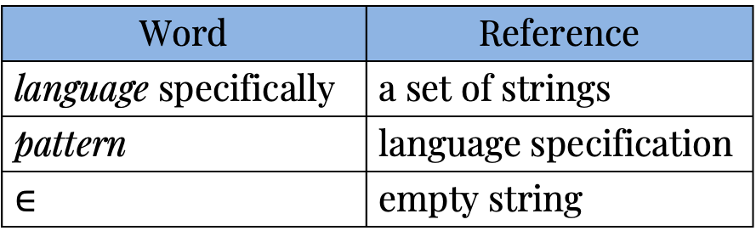
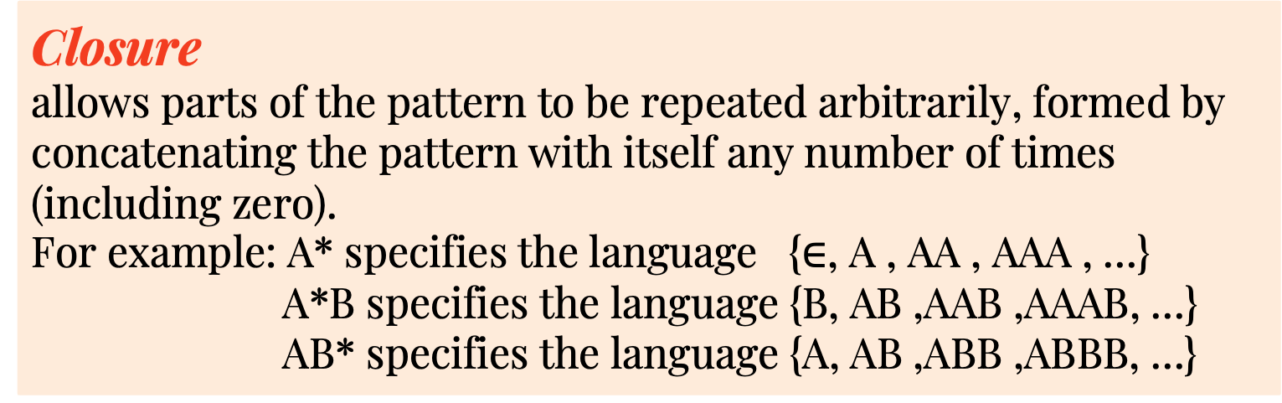
Describing pattern with Regex
Basic Rules:
Concatenation.
A B => specifying the language { A B } that has one two-character string, formed by concatenating A and B.
Word | Reference
language specifically | a set of strings
pattern | language specification
$$∈$$ | empty string
Or
an or ( | ) between two alternatives, then both are in the language
For example: A | B specifies the language {A,B}
***Concatenation has higher precedence than or
=> A B | B C D specifies the language { A B , B C D }
Example:
Closure
allows parts of the pattern to be repeated arbitrarily, formed by concatenating the pattern with itself any number of times (including zero).
For example: A* specifies the language {$∈$, A , AA , AAA , …}
A*B specifies the language {B, AB ,AAB ,AAAB, …}
AB* specifies the language {A, AB ,ABB ,ABBB, …}
RE | Matchs | Does not match
(A|B)(C|D) | AC AD BC BD | Every other string
A(B|C)*D | AD ABD ACD ABCCBD | BCD, ADD, ABCBC
A*|(A*BA*BA*) * | AAA BBAABB BABAAA | ABA, BBB, BABBAAA
Parentheses.
use parentheses to override the default precedence rules.
For example: C(AC|B)D specifies the language { CACD, CBD}

Slide 72
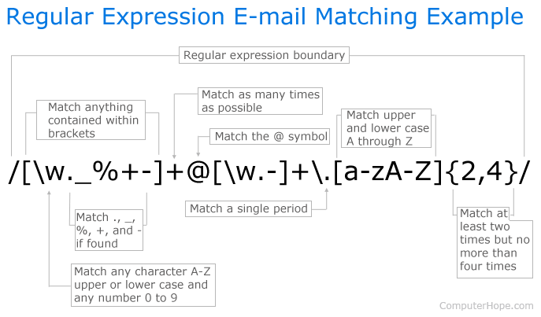
REs in applications
Search

Slide 73
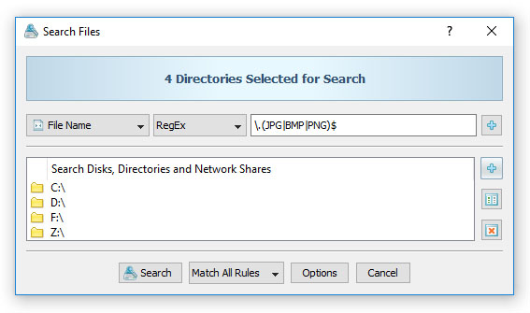
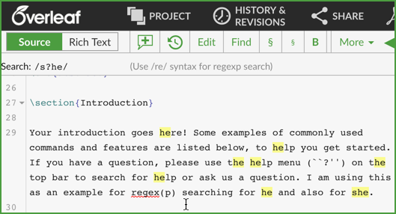
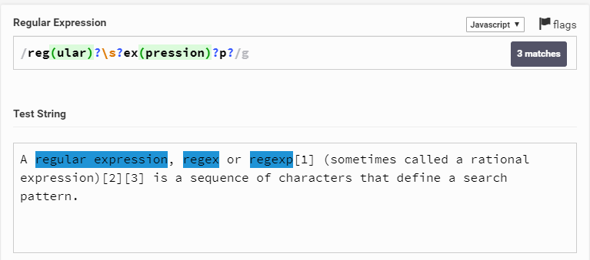
REs in applications
Search

Slide 74
REs in applications
Validity checking
Context | Regular expression | Matches
Substring search | .*NEEDLE.* | A HAYSTACK NEEDLE IN
Phone number | \([0-9]{3}\)\ [0-9]{3}-[0-9]{4} | (800) 867-5309
Java identifier | [$_A-Za-z][$_A-Za-z0-9]* | Pattern_matching
Genome marker | gcg(cgg|agg)*ctg | gcgaggaggcggcggctg
Email address | [a-z]+@([a-z]+\.) + (edu|com) | rs@cs.princeton.edu
Typical regular expression in applications (simplified versions)

Slide 75
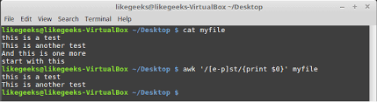
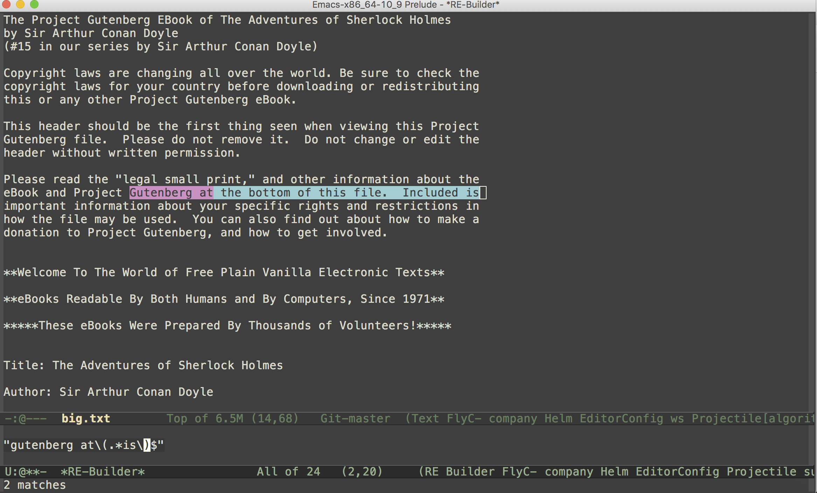
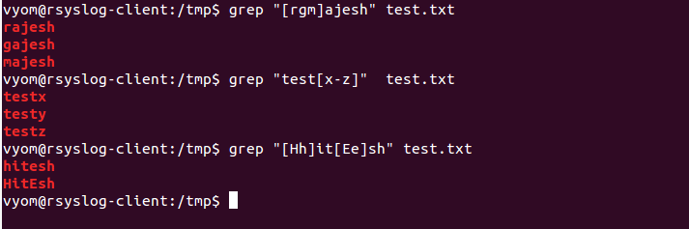
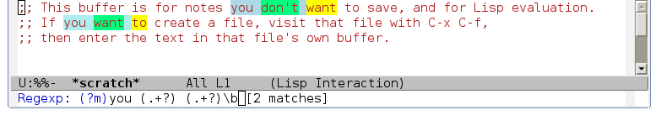
REs in applications
Programmer’s toolbox

Slide 76
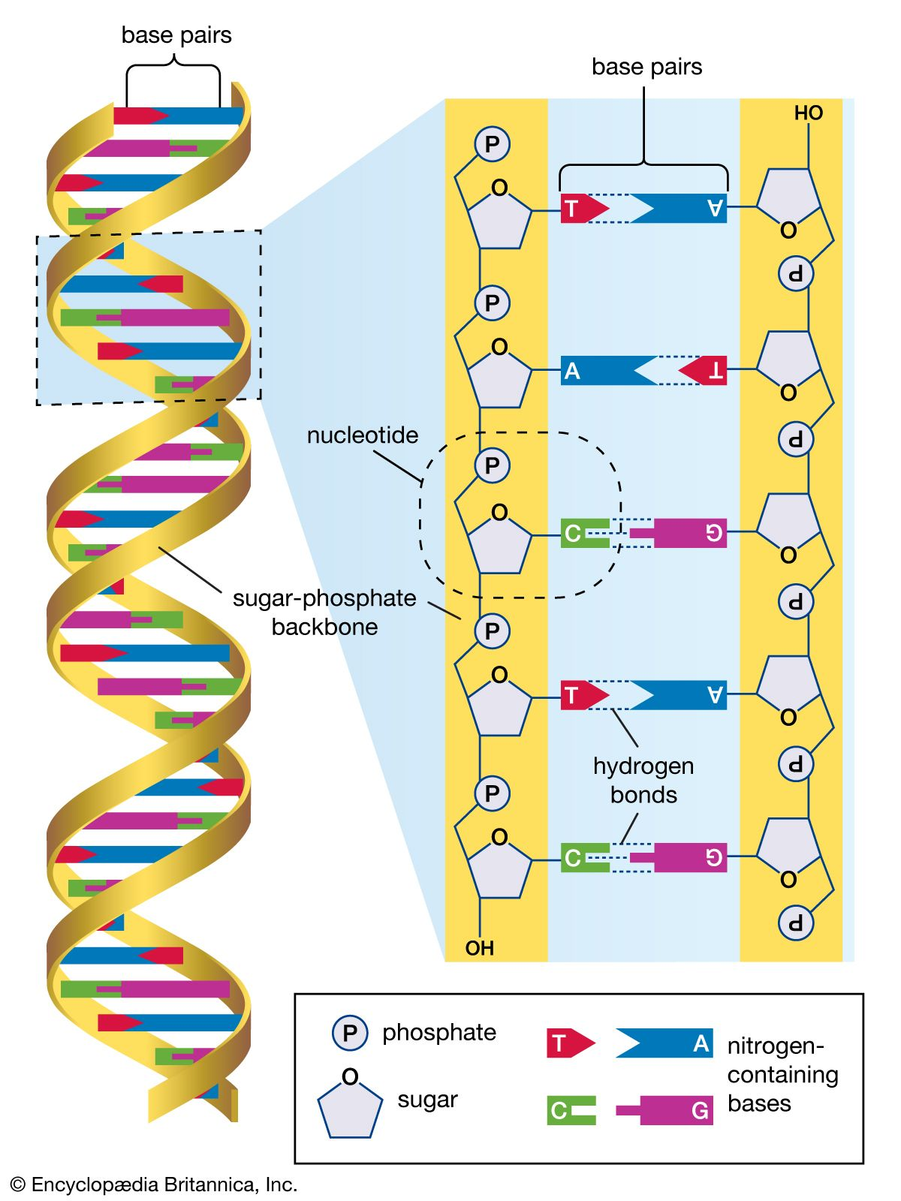
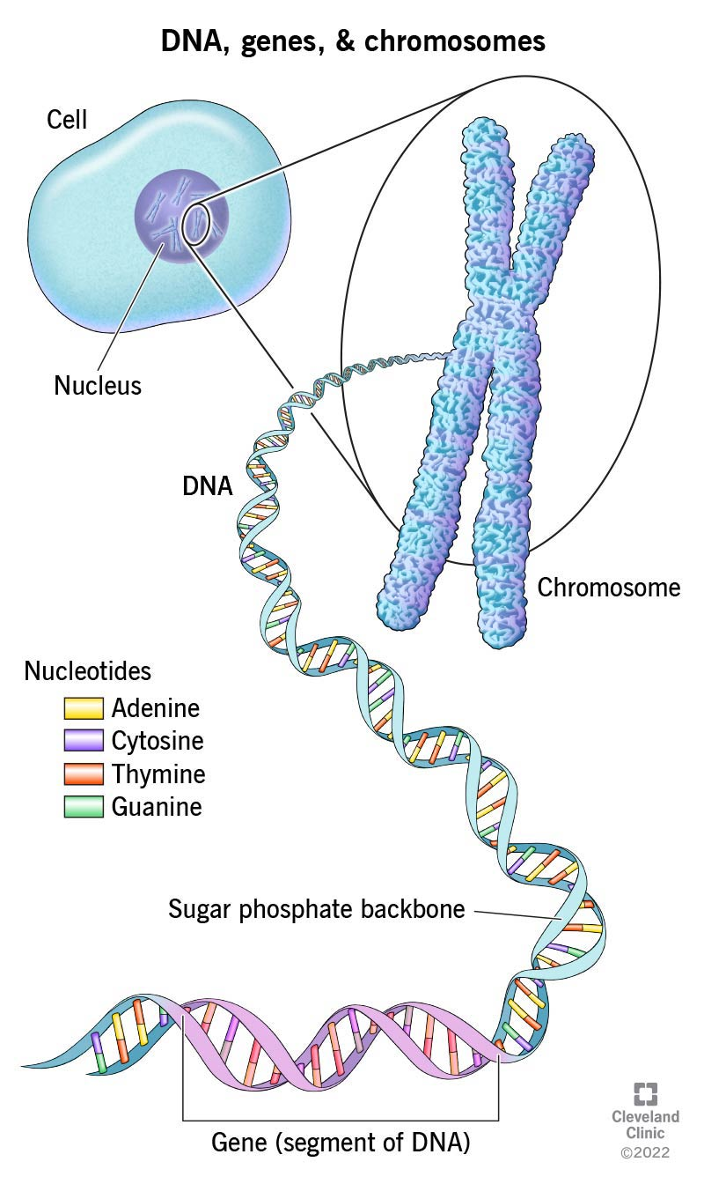
REs in applications
Genomics

Slide 77
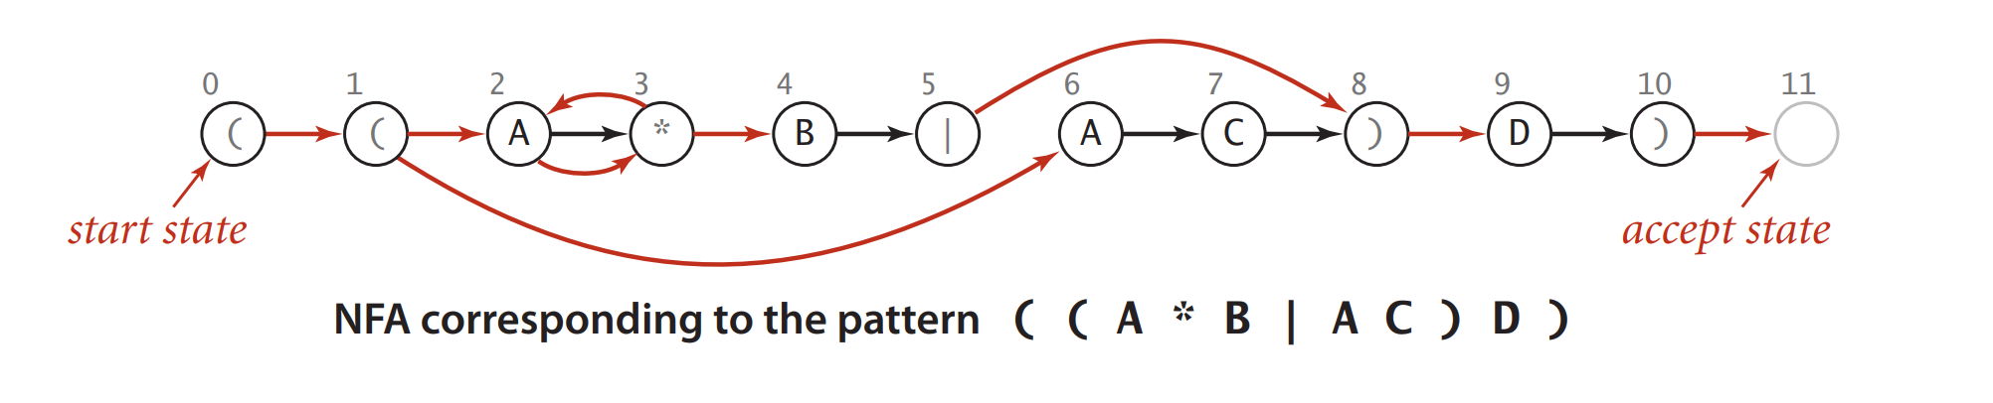
Non-deterministic finite-state automata
Kleene’s Theorem, a fundamental result of theoretical computer science, asserts that there is an NFA corresponding to any given RE (and vice versa).
- Consider the figure below, which shows an NFA that determines whether a text string is in the language described by the RE ( ( A * B | A C ) D ) .

Slide 78
Non-deterministic finite-state automata
The NFA corresponding to an RE of length M has exactly one state per pattern character, starts at state 0, and has a (virtual) accept state M.
States corresponding to a character from the alphabet have an outgoing edge that goes to the state corresponding to the next character in the pattern (black edges in the diagram).
States corresponding to the metacharacters (, ), |, and * have at least one outgoing edge (red edges in the diagram), which may go to any other state.
Some states have multiple outgoing edges, but no state has more than one outgoing black edge.

Slide 79
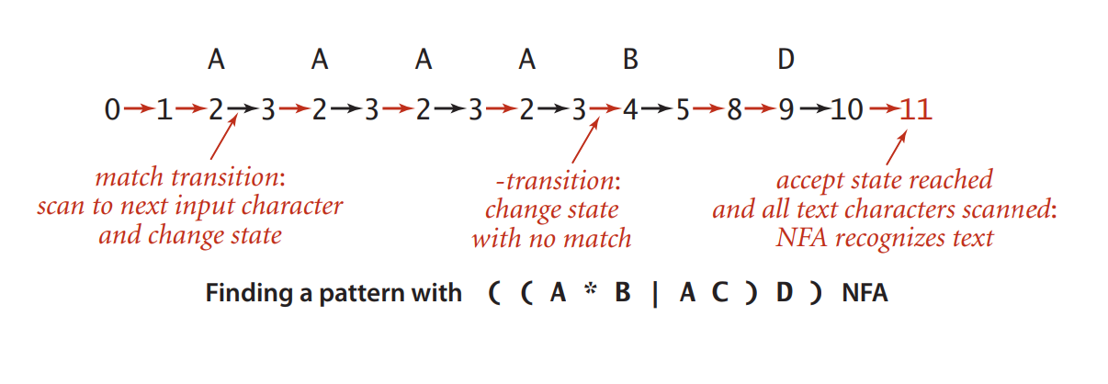

Non-deterministic finite-state automata
- The rules for moving from one state to another are also different than for DFAs—an NFA can do so in one of two ways:
If the current state corresponds to a character in the alphabet and the current character in the text string matches the character, the automaton can take the (black) transition to the next state - a match transition.
The automaton can follow any red edge to another state without scanning any text character. We refer to such a transition as an $ε$-transition, referring to the idea that it corresponds to “matching” the empty string $ε$.

Slide 80

Non-deterministic finite-state automata

Slide 81

Non-deterministic finite-state automata
Simulating the NFA
Idea: To simulate an NFA, we keep track of the set of states that could possibly be encountered while the automaton is examining the current input character.
Steps:
For each such state, we check whether a match transition for the first input character is possible. This check gives us the set of possible states for the NFA just after matching the first input character.
To this set, we add all states that could be reached via $ε−$transitions from one of the states in the set.
Given the set of possible states for the NFA just after matching the first character in the input, the solution to the multiple-source reachability problem in the transition digraph gives the set of states that could lead to match transitions for the second character in the input.
Iterating the process until all text characters are exhausted leads to one of two outcomes:
+) The set of possible states contains the accept states → report success
+) The set of possible states does not contain the accept state → report failure

Slide 82

Non-deterministic finite-state automata
Simulation of ( ( A * B | A C ) D ) NFA for input A A B D

Slide 83

Non-deterministic finite-state automata
Simulation of ( ( A * B | A C ) D ) NFA for input A A B D

Slide 84

Non-deterministic finite-state automata
Simulation of ( ( A * B | A C ) D ) NFA for input A A B D

Slide 85

Non-deterministic finite-state automata
Simulation of ( ( A * B | A C ) D ) NFA for input A A B D

Slide 86

Non-deterministic finite-state automata
Simulation of ( ( A * B | A C ) D ) NFA for input A A B D

Slide 87

Non-deterministic finite-state automata
Building an NFA corresponding to an RE

Slide 88

Non-deterministic finite-state automata
Building an NFA corresponding to an RE
- Another example of an NFA corresponding to the given pattern.

Slide 89


Non-deterministic finite-state automata
Building an NFA corresponding to an RE
- Taking a cue from Dijkstra’s algorithm, we will use a stack to keep track of the positions of left parentheses and or operators.
Building the NFA corresponding to ( ( A * B | A C ) D )

Slide 90

Homework
Construct the KMP DFA table and the LPS array for the following pattern string:
ABAABCABAABCB
2. Compute the right[] array for the pattern: ABRACADABRA.
3. Convert the following NFA graph to the corresponding RE.

Slide 91

thank you!

